Slide 1
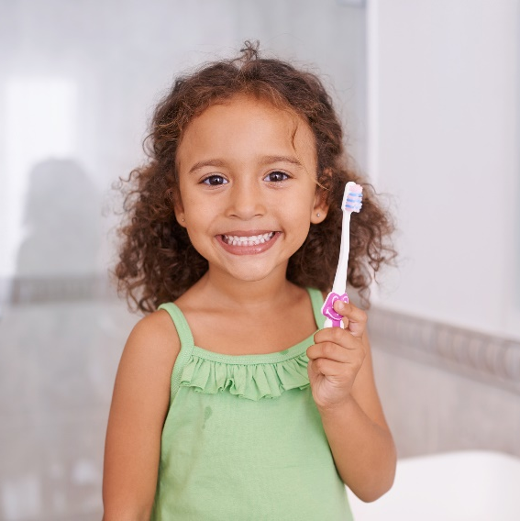
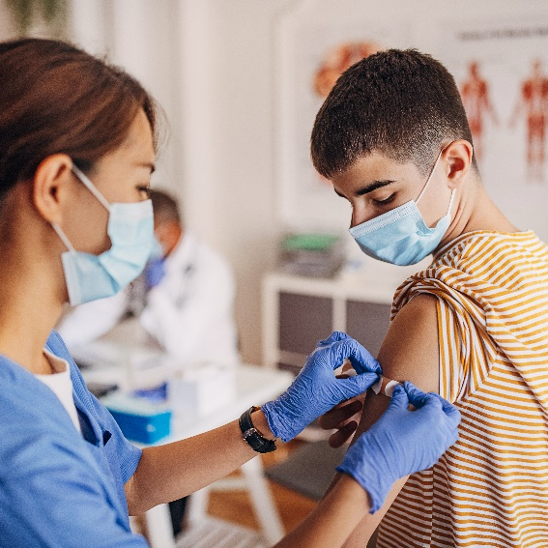
Decisions about sexual activity: Contraception
Recommended for Grade 9
Created by: Child Health Team
Created: January 2014
Updated: May 2022
Notes:
This presentation addresses topic areas of the Human Development and Sexual Health section D1.4, D2.3 and D3.3 of the Grade 8 Ontario Health and Physical Education Curriculum.
To provide an inclusive environment for all students, regardless of their gender identity, we use the names of body parts and hormones to discuss physical differences rather than the use of gender.

Slide 2
Class Guidelines
Giggling is okay
Be respectful
Everyone is learning, ask questions!
Discuss sexual health topics responsibly outside the classroom
Notes:
Ask students to contribute ideas to add to the guidelines

Slide 3
Everyone has the right to choose:
If they want to be in a relationship
Who they want to be in a relationship with
How intimate they want to be with their partner
Notes:
Image source: https://www.pexels.com/photo/hands-on-a-metal-railing-7496143/

Slide 4
What is Intimacy?
The ways that people show caring connection with each other
hugging
touching genitals
kissing
touching bodies
holding hands
sexual intercourse
Notes:
Image source: canva.com
Can you think of any non-physical ways people might be intimate? E.g. having long conversations, talking about intimate things, sharing secrets

Slide 5
What is Abstinence?
Abstinence means to not do something
Sexual abstinence means to abstain from different levels of sexual activity
Possible choices for sexual abstinence could be:
Avoiding vaginal and anal intercourse
Avoiding oral-genital contact
Avoiding genital contact
Notes:
Ensure that the students note that:
. there is confusion, even among adults, about whether having sex includes only intercourse
. Canadian young people are experimenting with different levels of sexual activity
. oral sex is not free of STI and other risks
. abstaining at lower levels of sexual activity (outercourse) can eliminate risk of pregnancy and STI
Abstaining is not necessarily forever, and it is not only for virgins.

Slide 6
Consent
https://www.youtube.com/watch?v=raxPKklDF2k
Notes:
Optional Consent Quiz through Kids Help Phone: https://kidshelpphone.ca/get-info/quiz-consent/
FRENCH VIDEO: https://www.youtube.com/watch?v=AaKoSIeLAKc

Slide 7
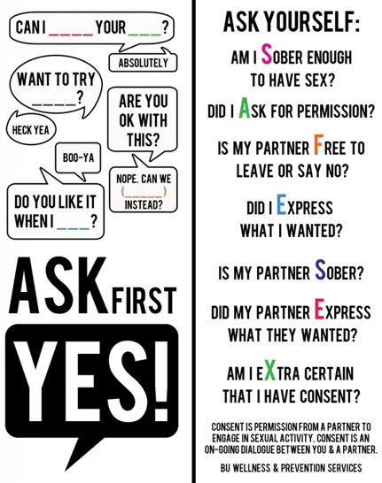
Consent
Notes:
There are different ways to refuse intimacy, here are some ways to communicate "No"
No
Stop
Not now
I’m not ready
I don’t want to
I need to study
I’m not feeling well
I have to go home now
I need to use the bathroom
Physically pushing someone away
I don’t feel comfortable
Let’s do something else
I don’t think I should
I’m not in the mood
Can we slow down?
I have to leave soon
I need to think about it
I need more time
Not here
I really like you but I don’t want to do more
Setting boundaries is another way to communicate comfort level with different levels of intimacy, sharing with your partner exactly what you are comfortable with.
Image source: wordart.com

Slide 8
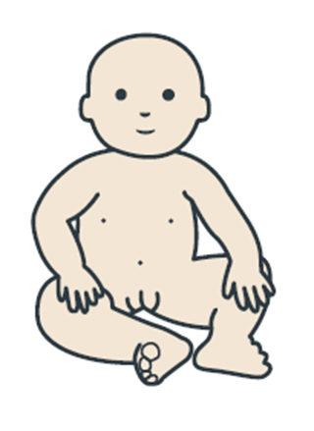
Reproduction and Anatomy Review
Sperm + Egg = Baby
Notes:
Images not to scale
Image Source: Adobe Stock-purchased
https://www.secca.org.au/ with permission

Slide 9
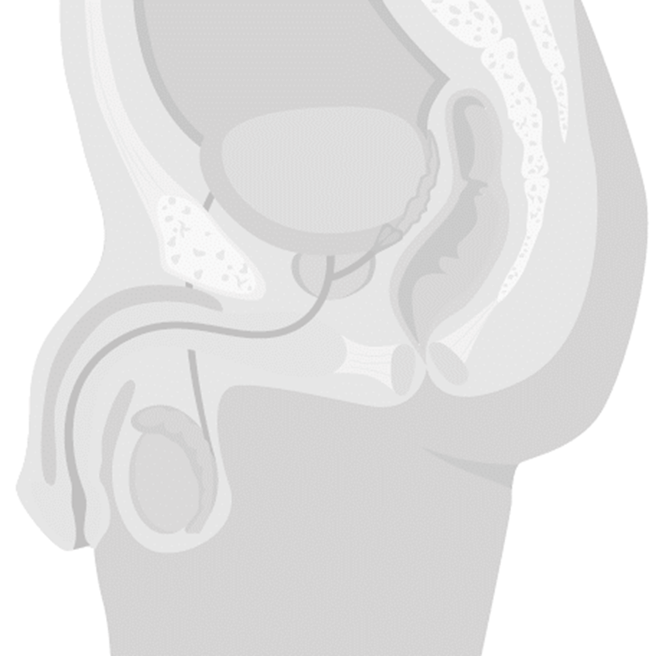
Person with a penis
Bladder
Seminal vesicle
Prostate gland
Vas deferens
Urethra
Epididymis
Testicle
Scrotum
Notes:
Penis – It is a spongy, muscular organ that becomes enlarged and erect when sexually aroused.
Scrotum – The sac of skin which holds the pair of testes.
Testicles (testes) – The male sex glands which produce sperm and testosterone (a male hormone).
Epididymis – A tube on the surface of each testicle which stores and transports sperm to the vas deferens.
Vas deferens- A tube that transports sperm from the testicle to the seminal vesicle
Seminal vesicles – Pair of glands which add a nourishing fluid to the sperm
Prostate gland – Gland which adds a milky fluid to the semen. Once sperm is combined with the fluid from the seminal vesicles and prostate gland it is called semen
Bladder – A bag-shaped organ which holds the urine until it is discharged.
Urethra – The tube that goes through the penis, through which urine and semen leave the body.
Image Source: Adobe Stock-purchased (MLHU)

Slide 10
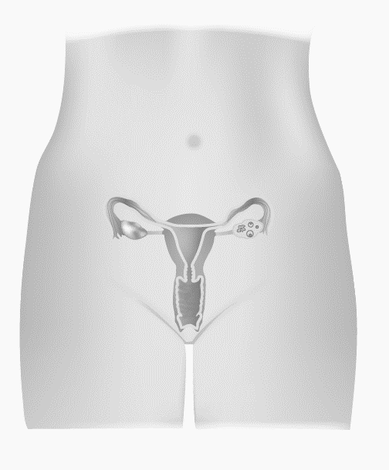
Person with a vulva
Fallopian tubes
Ovaries
Uterus
Cervix
Vagina
Notes:
Vulva – The name for the external genitalia
Ovary – Releases egg cells and produces hormones (estrogen and progesterone) on a monthly cycle.
Fallopian Tubes – Tubes leading from the ovary to the top of the uterus, with finger-like projections that surround an ovary.
Uterus – Pear-shaped organ which nourishes and holds a developing fetus. It prepares for a pregnancy each month by forming a blood and tissue lining.
Cervix – The narrow inner end of the vagina, which leads to the uterus.
Vagina – A muscular tube which expands to fit the penis during intercourse or a baby during birth.
Image Source: Adobe Stock-purchased (MLHU)

Slide 11
The Menstrual Cycle
https://www.youtube.com/watch?v=vXrQ_FhZmos
Notes:
https://www.youtube.com/watch?v=vXrQ_FhZmos
*Note to teachers: This video includes the use of gendered language (woman, girl, her) in the explanation of menstruation. In this presentation we endeavour to be more inclusive in our education, recognizing that not all youth identify with a specific gender.

Slide 12
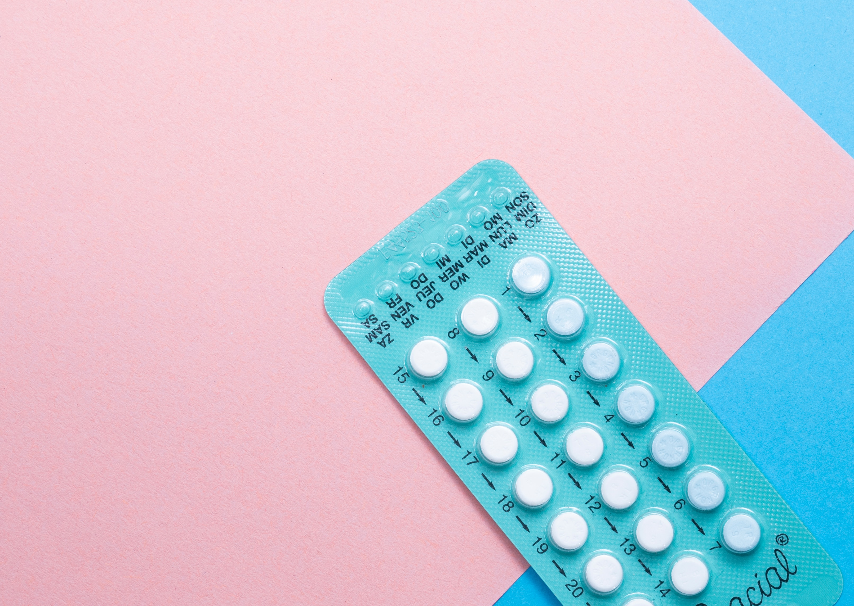
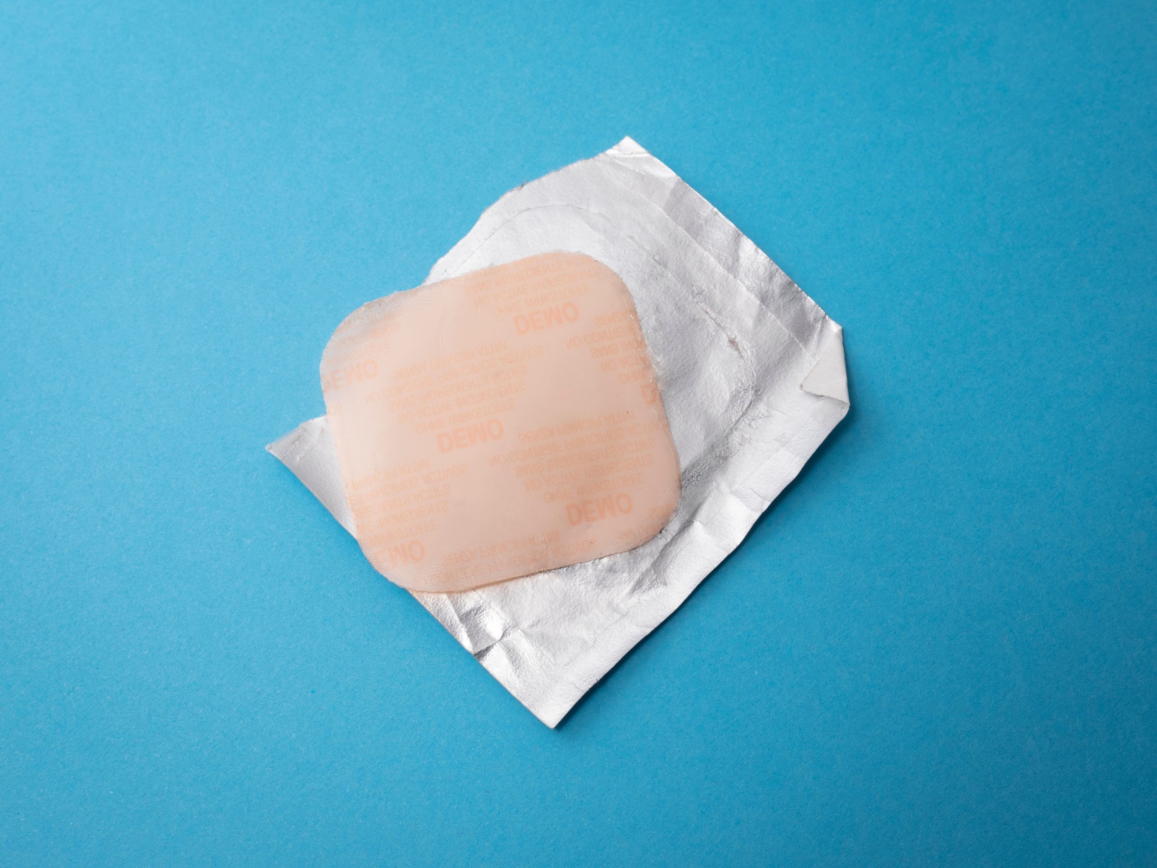
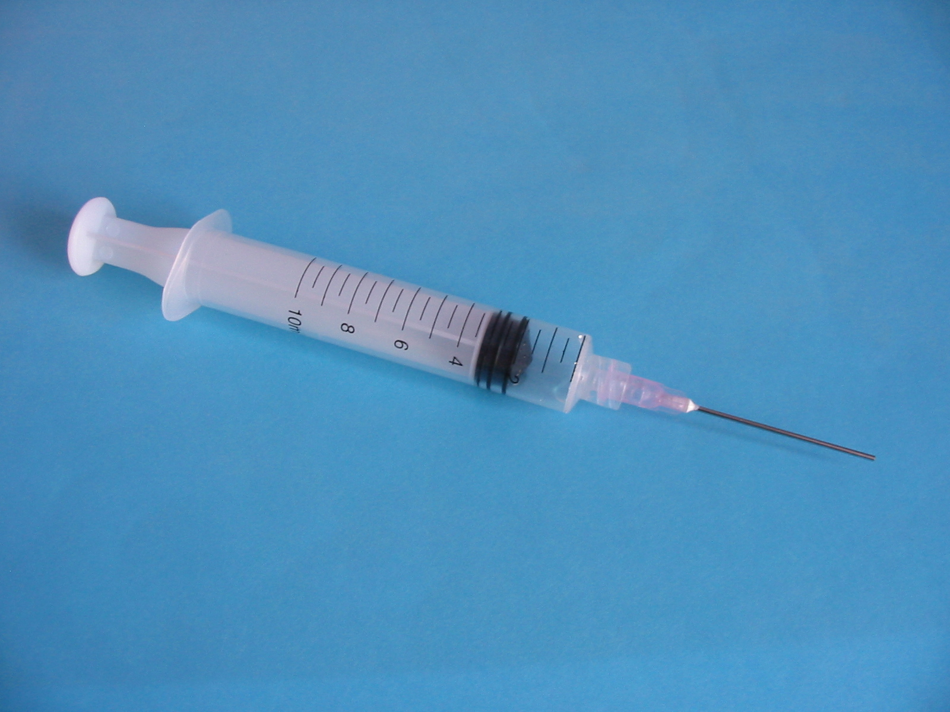
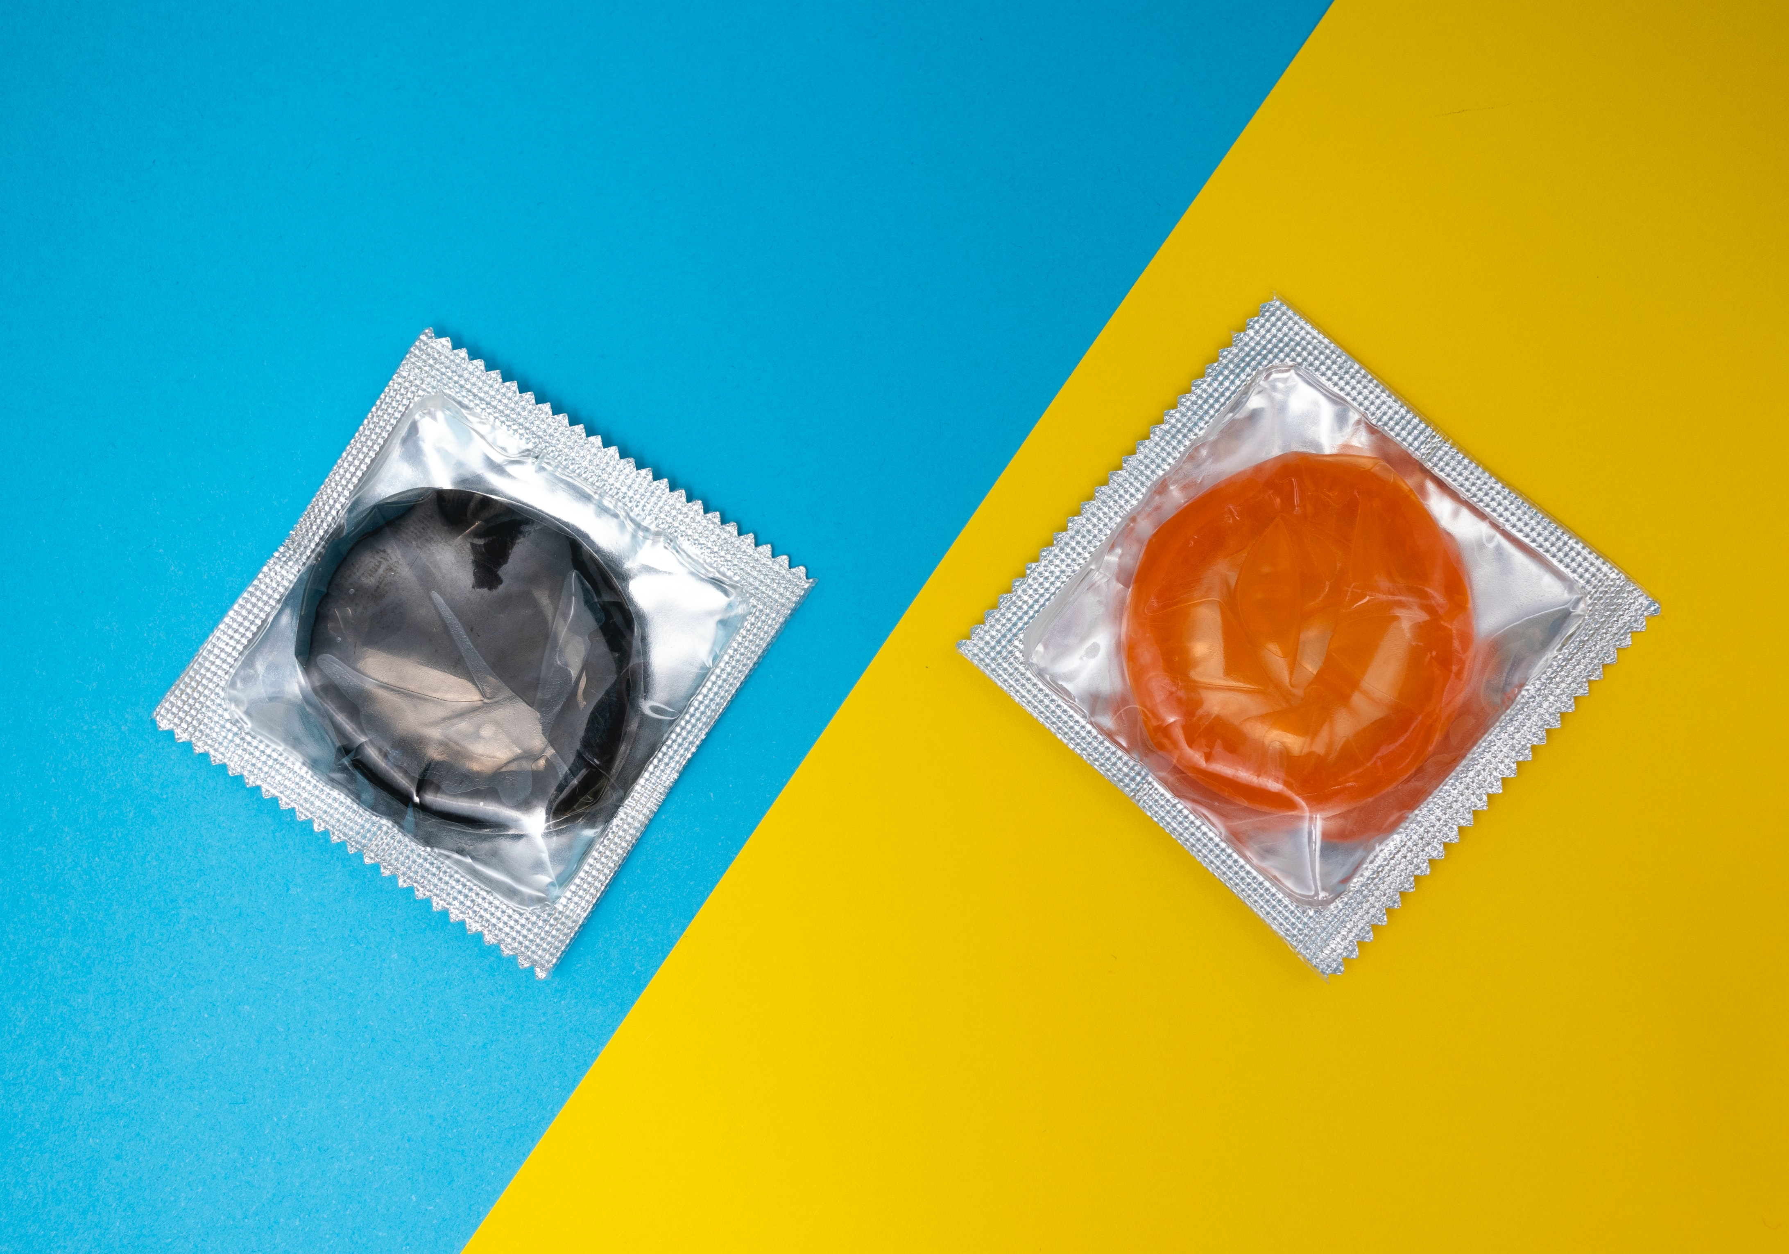
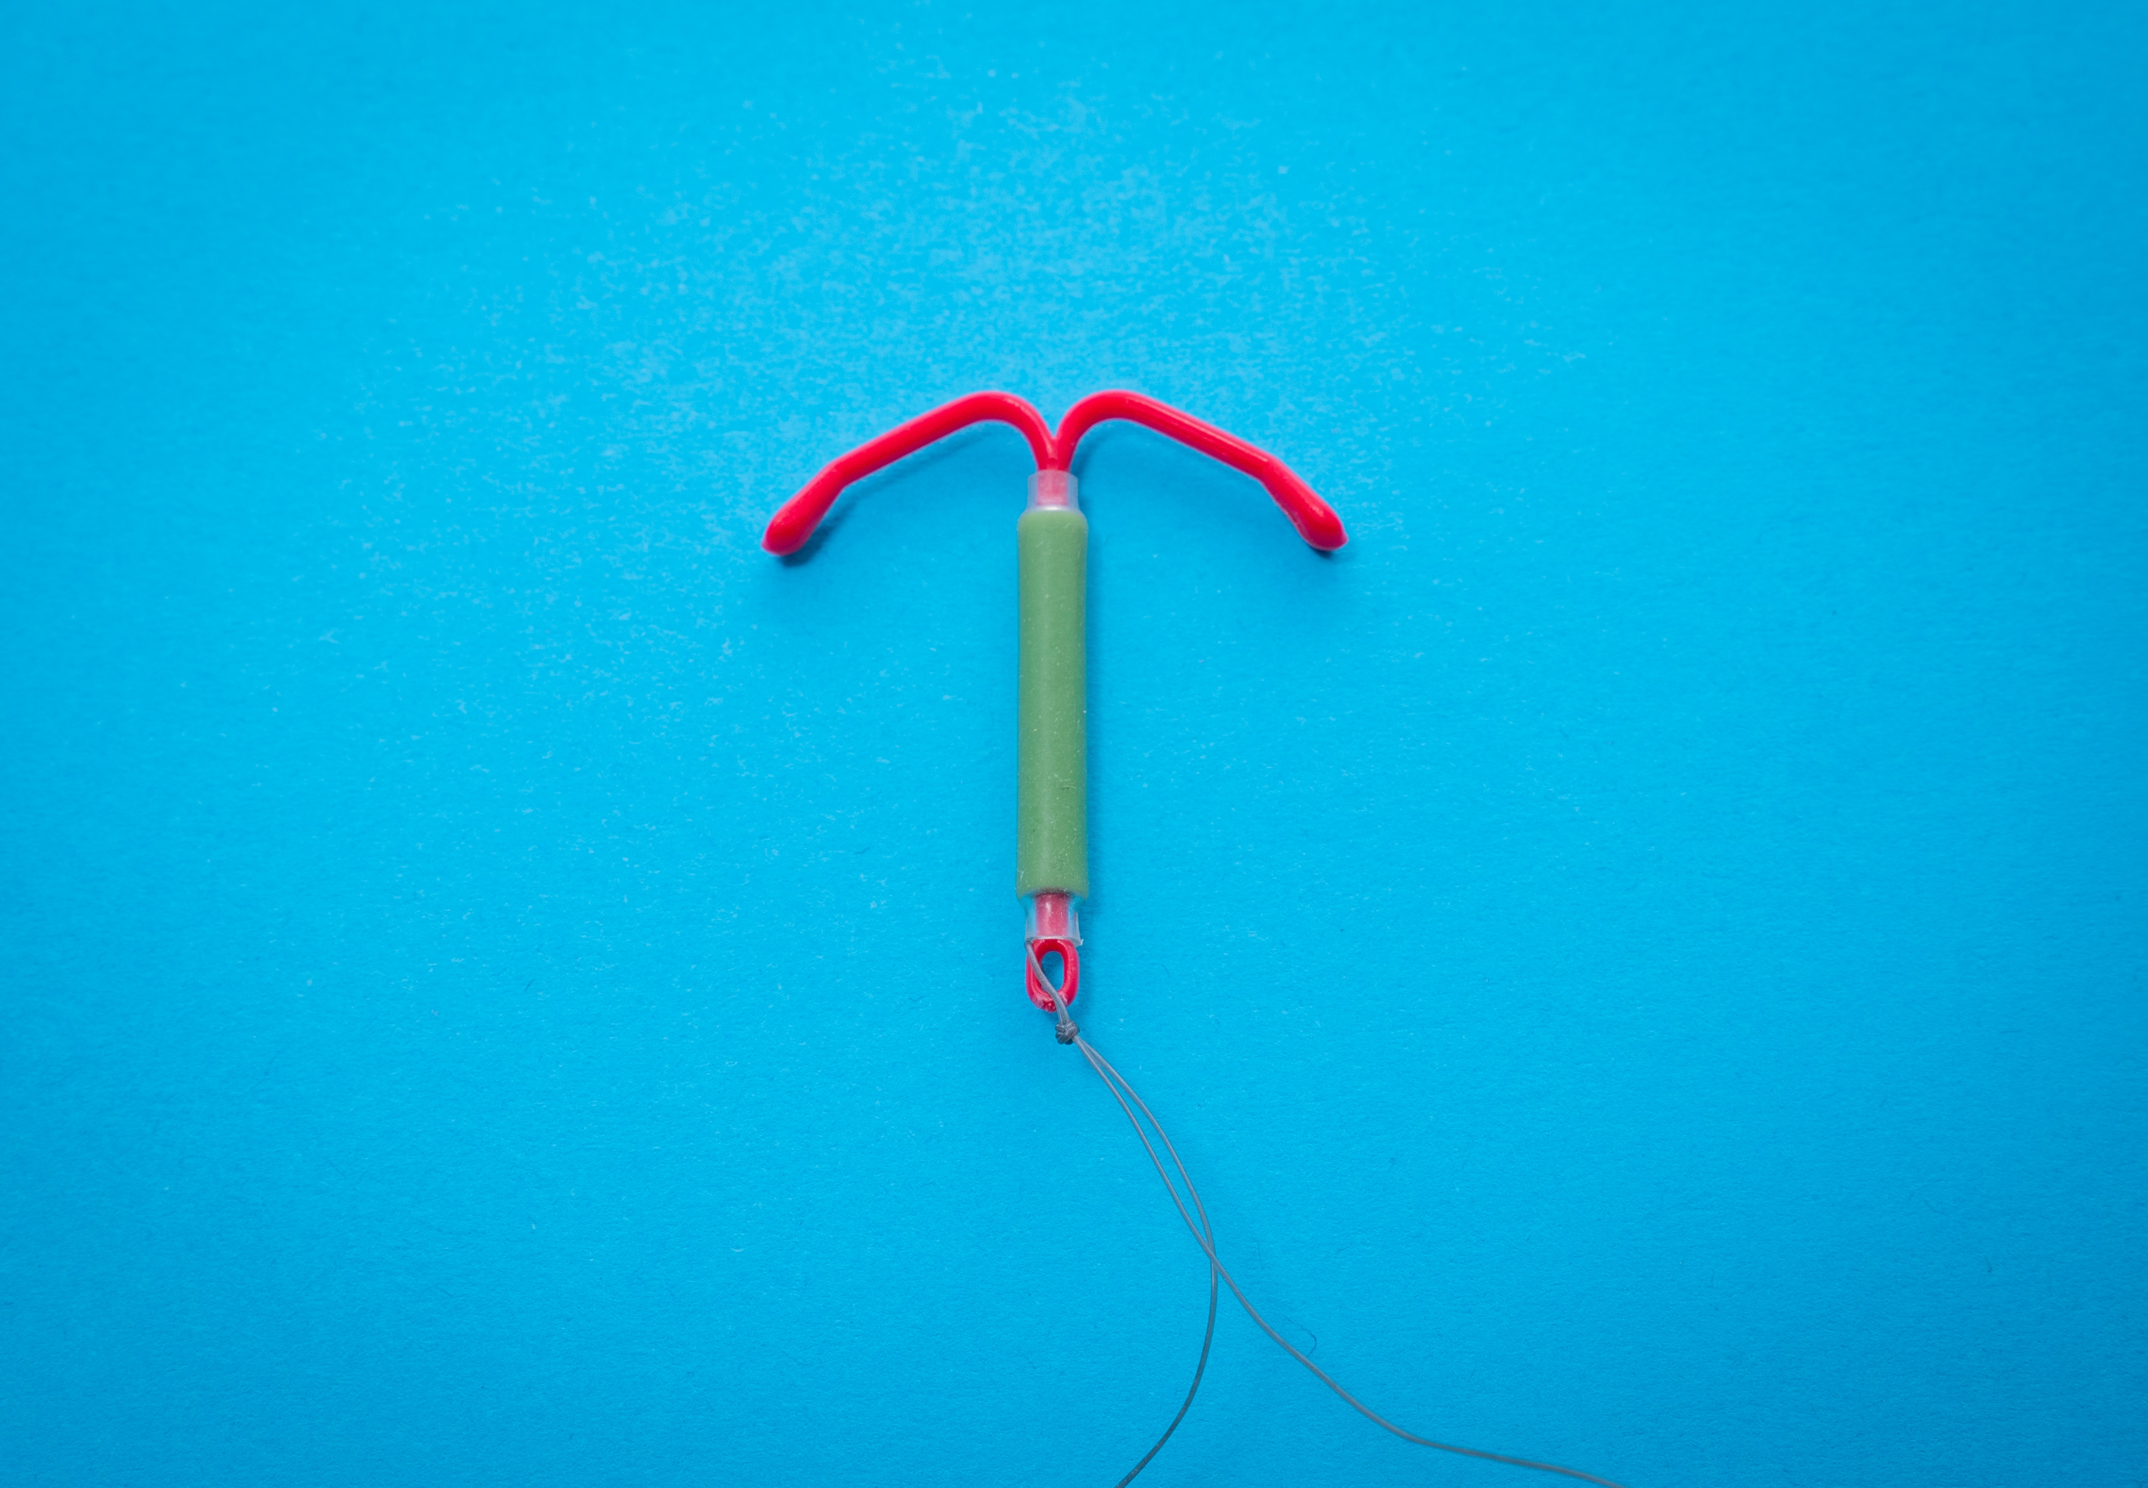
Contraception
Preventing pregnancy, also known as birth control
Abstinence
Hormonal Methods
Non-Hormonal Method

Slide 13
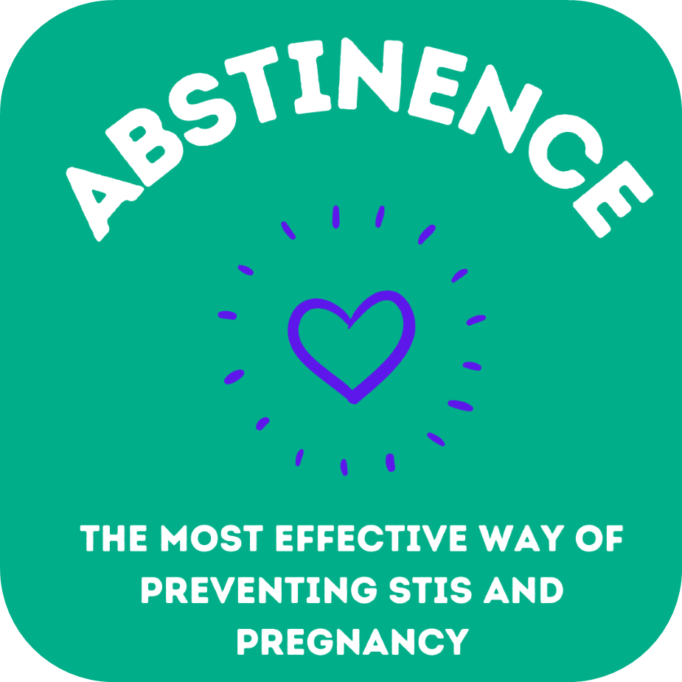
Notes:
Abstinence is the only 100% effective method against STIs and pregnancy if there is no vaginal, anal, oral sex or skin to skin contact.
Ask the class what other ways two people can be intimate if they are practicing abstinence. (e.g. hugging, holding hands, kissing)
“No one should feel pressured to engage in sexual activity” (Ontario Curriculum, Grades 1-8; Health and Physical Education 2019)
What should students consider when setting personal limits on physical intimacy? e.g. family and personal values, religious beliefs, risks and how to reduce risks
Image source: canva.com (MLHU)

Slide 14
Hormonal Methods
Contain estrogen, or estrogen and progesterone
Can prevent pregnancy by:
Stopping the release of a mature egg
Thickening cervical mucous
Changing the lining of the uterus
DO NOT protect against STBBIs (sexually transmitted and blood borne infections)
Notes:
Estrogen and progesterone are the hormones produced in the ovaries.
Please note the effective rates on the following slides are based on typical use.

Slide 15
The Pill
Must be taken consistently every day
91% effective
Notes:
There are combination pills that contain estrogen and progestin and progestin-only pills.
To be fully effective at preventing pregnancy, the pill needs to be taken at the same time every day for a full cycle (28 days), before intercourse.
A prescription from a healthcare provider is needed.
The pill does not protect against sexually transmitted an blood-borne infections, using a condom as well as being on the pill will provide additional protection.
The combination pill may decrease acne, improve period symptoms such as cramping, and regulate the menstrual cycle.
The pill is reversible, when someone stops taking it, they can get pregnant.
References: https://www.sexandu.ca/contraception/hormonal-contraception/#tc1
https://sexualhealthontario.ca/en/reproductive-health#birth-control
Image Source: https://unsplash.com/photos/fgqLiOKNjU8

Slide 16
Transdermal Patch
Patch should be worn for 3 weeks, with patch changed weekly
91% effective
Notes:
The patch contains estrogen and progestin and is absorbed through the skin.
It is adhesive and can be placed on the buttocks, upper outer arms, lower abdomen, or upper torso excluding the breast
A new patch is applied once a week and the old patch is removed.
To be fully effective at preventing pregnancy, patches need to be worn for a full cycle before intercourse.
A prescription from a healthcare provider is needed.
The patch does not protect against sexually transmitted an blood-borne infections, using a condom as well as using the patch will provide additional protection.
The patch may improve period symptoms such as cramping and regulate the menstrual cycle.
The patch is reversible, when someone stops using it, they can get pregnant.
References: https://www.sexandu.ca/contraception/hormonal-contraception/#tc1
https://sexualhealthontario.ca/en/reproductive-health#birth-control
Image Source: https://unsplash.com/photos/lR1eWq2nl-Y

Slide 17
Vaginal Ring Brand name: Nuva Ring
Flexible ring inserted into the vagina once a month
91% effective
Notes:
The vaginal ring contains estrogen and progestin and is absorbed through the vagina.
It is inserted and removed by the user into the vagina once a month, the walls of the vagina hold it in place and usually cannot be felt.
To be fully effective at preventing pregnancy, the vaginal ring needs to be used for a full cycle before intercourse.
A prescription from a healthcare provider is needed.
The vaginal ring does not protect against sexually transmitted an blood-borne infections, using a condom as well as using the patch will provide additional protection.
The vaginal ring may improve period symptoms such as cramping and regulate the menstrual cycle.
The vaginal ring is reversible, when someone stops using it, they can get pregnant.
Reference: https://www.sexandu.ca/contraception/hormonal-contraception/#tc3
Image Source: https://unsplash.com/photos/utxGYPso0ZM

Slide 18
Injectable Contraceptive Brand name: Depo Provera
Administered every 12-13 weeks by health care provider
94% effective
Notes:
Also known as the birth control shot
The shot (Depo Provera) contains a progestin and is injected into the muscle by a healthcare provider
The shot is given once every 12-13 weeks
A prescription from a healthcare provider is needed.
The shot does not protect against sexually transmitted an blood-borne infections, using a condom as well as being on Depo Provera will provide additional protection.
The shot decreases or eliminates periods and may be suitable for individuals who cannot take estrogen.
The shot is reversible, when someone stops using it, they can get pregnant.
Reference: https://www.sexandu.ca/contraception/hormonal-contraception/#tc5
Image Source: https://upload.wikimedia.org/wikipedia/commons/1/1d/Syringe2.jpg

Slide 19
Intrauterine System - IUS Brand name: Kyleena or Mirena
T-shaped device inserted in the uterus by a healthcare professional
99% effective
Notes:
All IUSs require a prescription and to be inserted by a healthcare provider
The levonorgestrel-releasing intrauterine system (contains a progestin hormone), also known as LNG-IUS
An IUS can be in for up to 5 years depending on type inserted
An IUS may be suitable for individuals who cannot take estrogen.
An IUS can decrease or eliminate periods
IUSs do not protect against sexually transmitted an blood-borne infections, using a condom as well as having an IUC will provide additional protection.
References: https://www.sexandu.ca/contraception/hormonal-contraception/#tc4
https://sexualhealthontario.ca/en/reproductive-health#birth-control
Image Sources: https://unsplash.com/photos/rI0Uc7BPExo

Slide 20
99% effective
99% effective
Notes:
Image Source: sexandu.ca

Slide 21
Side Effects of Hormonal Methods
During the first few months of being on hormonal contraception, people can experience:
irregular bleeding, spotting
nausea
mood swings
bloating
breast tenderness
headaches
Notes:
Reason:
The body is getting used to birth control
Fluctuating hormone levels when birth control is started
When will it stop?
Most symptoms are normal and will decrease or stop in the first 2-3 months.
If they bother you or don’t get better:
Talk to your healthcare provider
There might be a method that’s better suited for you.

Slide 22
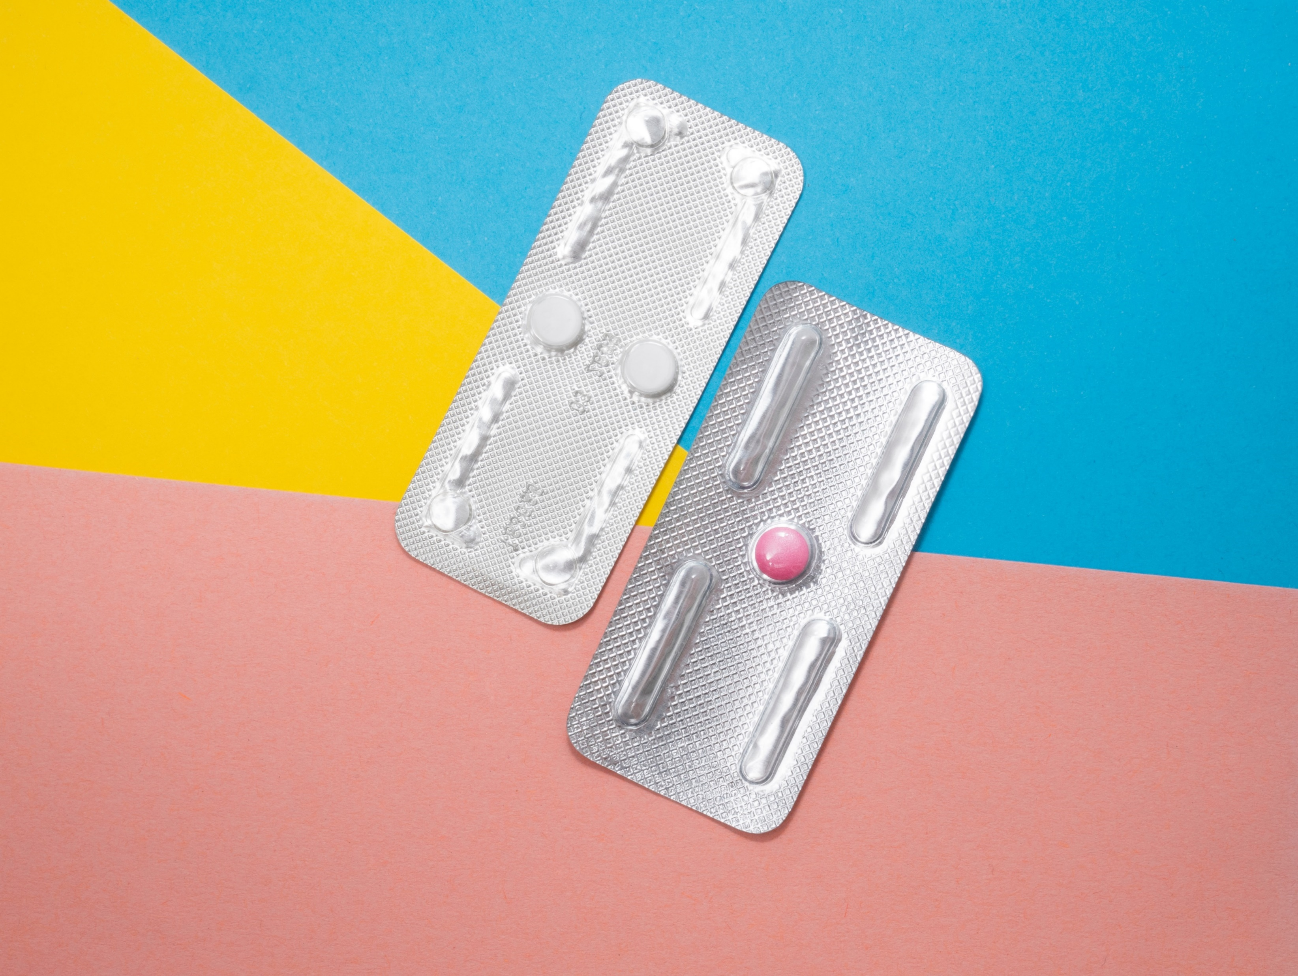
Emergency Contraception (the morning after pill)
Can be taken up to 5 days after intercourse
Delays or prevents the release of an egg
May prevent implantation of a fertilized egg
The sooner it is taken, the better it works
Occasional use only, not intended to be used as a primary method of birth control
Notes:
Also known as the “morning after pill”
A pill or pills taken after intercourse where other pregnancy prevention methods were not in place or have failed.
e.g. condom breakage, a missed pill, patch or injection
Emergency contraception is
95% effective if taken within 24 hours of intercourse
85% effective if taken 25-48 hours after intercourse
58% effective if taken 49-72 hours after intercourse
Some brands of morning after pill are available at a pharmacy without a prescription. It is important to read the packaging or speak to the pharmacist to ensure it is taken correctly and appropriately.
Some brands of morning after pill are available with a prescription from a healthcare provider.
Insertion of a copper IUD by a healthcare provider up to seven days after unprotected sex can also be used an emergency contraception
Reference: https://www.sexandu.ca/contraception/emergency-contraception/
Image Source: https://unsplash.com/photos/F2bTuiboieg

Slide 23
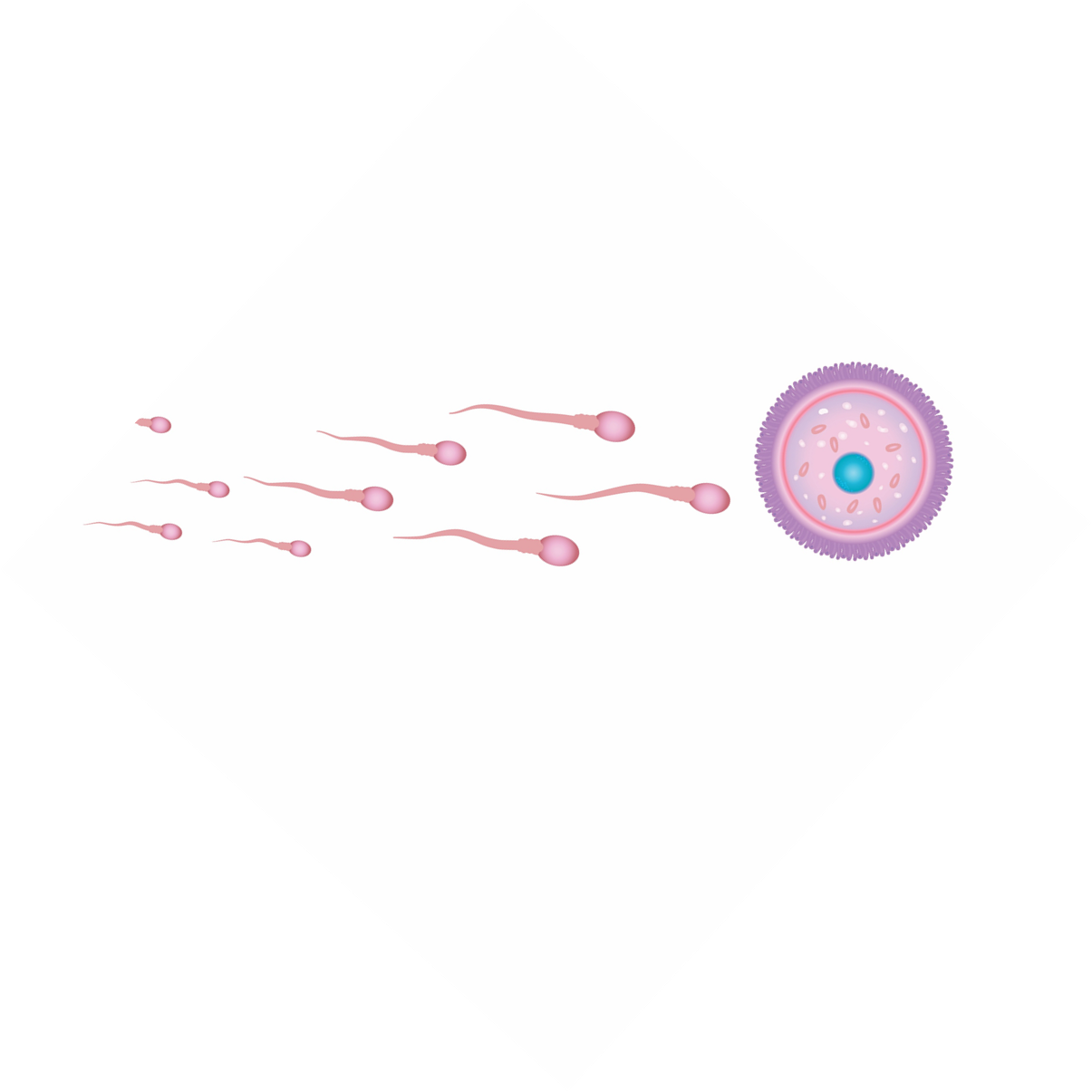
Non-Hormonal Methods
Prevents sperm and egg meeting

Slide 24
Condoms
Worn on an erect penis to catch sperm during ejaculation
82% effective
Notes:
Condom Demonstration: (may choose to demonstrate with a real condom while showing the slides)
https://teachingsexualhealth.ca/teachers/resource/using-a-condom-video/
Condoms are widely available at low or no cost and no prescription is required
Condoms catch sperm during ejaculation, preventing it from fertilizing an egg.
Made of thin latex or polyurethane
Condoms reduce the risk of spreading sexually transmitted and blood-borne infections and can be used in addition to other birth control methods for greatest protection.
Condoms need to be put on an erect penis before any skin to skin contact and removed and thrown away after ejaculation.
A new condom is needed with every act of intercourse.
Condoms have an expiry date and need to be stored correctly to reduce the risk of breaking.
References: https://www.sexandu.ca/contraception/non-hormonal-contraception/
https://sexualhealthontario.ca/en/reproductive-health#birth-control
Image Source: h ttps://unsplash.com/photos/Wb-rLP27Gvo

Slide 25
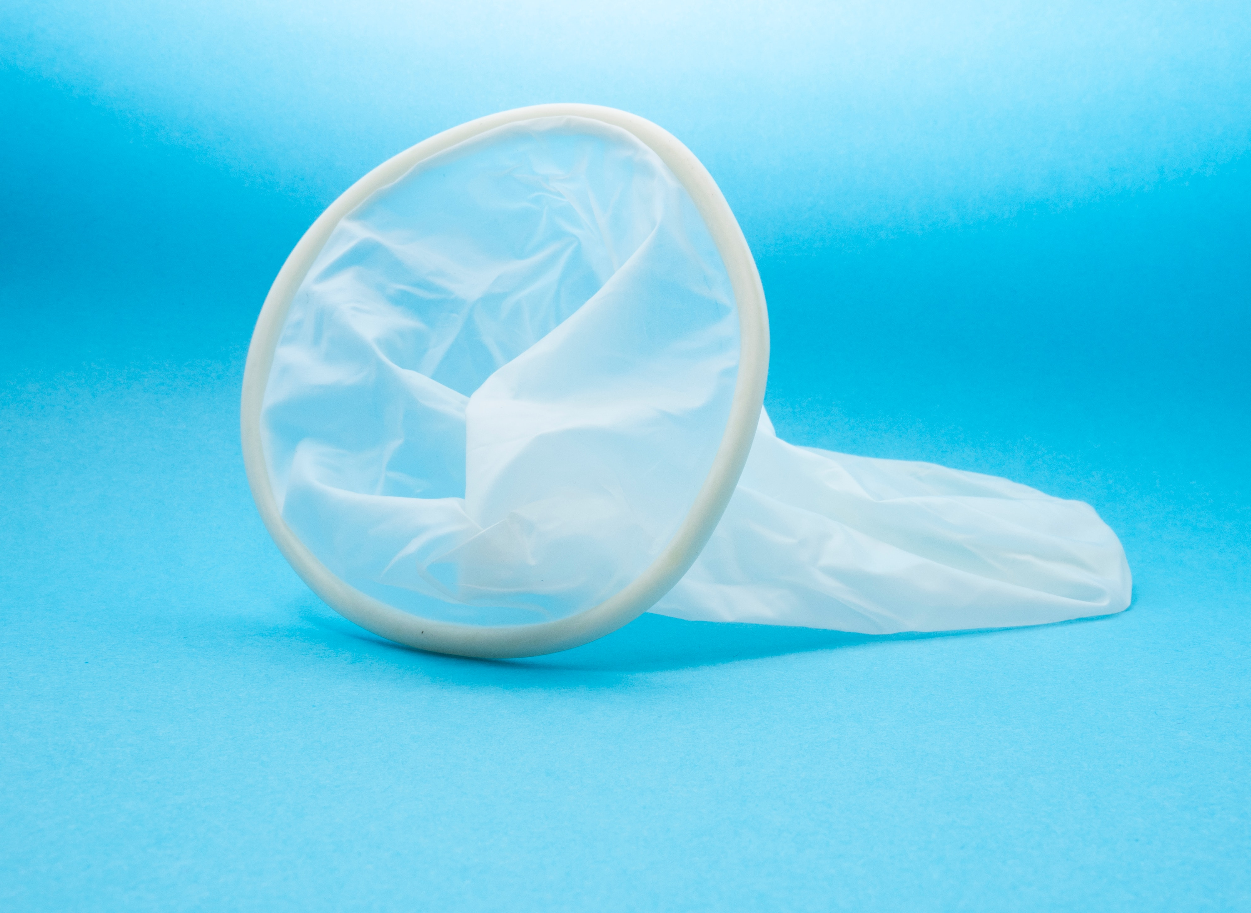
Internal Condom
Polyurethane sheath inserted into the vagina before sex
79% effective
Notes:
Provides a physical barrier to prevent sperm from entering cervical canal. Sperm is trapped in the condom which is thrown away after use.
Made of polyurethane, may be suitable for folks with an allergy to latex
Smaller flexible ring is inserted in the vagina and the larger ring sits outside of the vagina
Reduces the risk of spreading sexually transmitted and blood-borne infections and can be used in addition to other birth control methods for greatest protection.
A new condom is needed with every act of intercourse.
Available without a prescription at some pharmacies
Note: Also referred to as ‘female’ condom
References: https://www.sexandu.ca/contraception/non-hormonal-contraception/#tc2
https://sexualhealthontario.ca/en/reproductive-health#birth-control
Image Source: https://unsplash.com/photos/13TFAniXyKI

Slide 26
Intrauterine Device (IUD)
T-shaped device inserted in the uterus by a healthcare professional
99% effective
Notes:
All IUDs require a prescription and to be inserted by a healthcare provider
The copper intrauterine device does not contain hormones, also known as CU-IUD
An IUD can be in for up to 10 years depending on type inserted
An IUD may be suitable for individuals who cannot take estrogen.
IUDs do not protect against sexually transmitted an blood-borne infections, using a condom as well as having an IUC will provide additional protection.
References: https://www.sexandu.ca/contraception/non-hormonal-contraception/#tc9
https://sexualhealthontario.ca/en/reproductive-health#birth-control
Image Source: reproductive-health-supplies-coalition-cHrcHdg2H9E-unsplash.jpg

Slide 27
Who to talk to
Partner
Parents or other family members
Other trusted adults (teachers)
Health professionals (Your school public health nurse)
Notes:
Partner: Having a discussion about contraception before being sexually active allows individuals to consider their personal values and options before being in the moment. Many contraceptive options require an appointment with a healthcare provider and time to become effective.

Slide 28
How to access OHIP+
You are covered by OHIP+ if you are 24 years old or under, have OHIP coverage, and are not covered by a private plan
OHIP+ covers the cost of more than 5,000 eligible drug products that are currently available through the Ontario Drug Benefit program
Obtain your eligible prescription from your health care provider, or have it called in or faxed to a pharmacy
Take your health card OR health card number to the pharmacy – you don’t need a separate or special card. Your pharmacist may ask if you are covered by a private plan.
If you do not have a private plan, the pharmacy will fill your eligible prescription at no charge .
Notes:
Partner: Having a discussion about contraception before being sexually active allows individuals to consider their personal values and options before being in the moment. Many contraceptive options require an appointment with a healthcare provider and time to become effective.

Slide 29
Where to get more information
https://www.swpublichealth.ca/en/my-health/birth-control.aspx
www.sexandu.ca/contraception
www.itsaplan.ca

Slide 30
Birth Control Clinics
Our clinics in St. Thomas and Woodstock offer:
Birth control counselling and prescriptions
STI testing and treatment
Inexpensive birth control and emergency contraception
Free Condoms

Slide 31
Pregnancy Options
It is important for you to have reliable and accurate information, so you can make the choice that is right for you.
Our clinic service providers can help guide you through your decisions and options.
Sexual Health clinic at SWPH offers a confidential services in a non-judgmental and non-discriminatory, safe environment.

Slide 32
Birth Control Clinics
St. Thomas Sexual Health Clinic
Southwestern Public Health - St. Thomas Site 1230 Talbot Street, St. Thomas 519-631-9900 ext. 1278
Drop-In Clinic
Mondays 9AM-1PM Wednesdays 1PM-4PM Fridays 9AM-3PM
No appointment required
Physician-Led Clinic
**Appointments required, please call to book at 519-631-9900 ext. 1278
Woodstock Sexual Health Clinic
Southwestern Public Health - Woodstock Site 410 Buller Street, Woodstock 519-539-4431 or 1-800-922-0096 (follow the prompts to reach the Sexual Health Team)
By Appointment Only
Mondays 1:15PM-4PM Wednesdays Every Other Week 9AM-4PM (closed 12PM-1PM) Opposite Wednesdays Late Clinic 1:15PM-6PM
**Appointments required Call to book at 519-539-4431
Physician-Led Clinic
**Appointments required, please call to book at 519-539-4431

