Slide 1
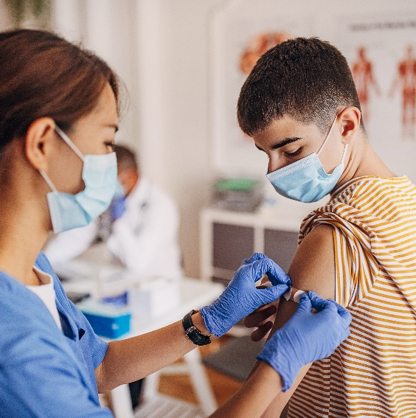
Jeopardy

Slide 2
STIs
Safer Sex
STI
Transmission
Condoms
$100
$100
$100
$100
$200
$200
$200
$200
$300
$300
$300
$300
$400
$400
$400
$400

Slide 3
STI’s- $100 Question
Which bacterial STI is most common??
Chlamydia
Back to Board

Slide 4
STI’s- $200 Question
What is the most common symptom for people who have Chlamydia or Gonorrhea?
No symptoms at all
Back to Board

Slide 5
STI’s- $300 Question
An outbreak of which viral STI, is characterized by burning or itching around the genitals followed by painful blisters?
Herpes
Back to Board

Slide 6
STI’s- $400 Question
List 5 ways a person could get an STI
Oral Sex
Vaginal Sex
Anal Sex
Skin to Skin Contact
Sharing Sex Toys
During pregnancy/birth from mother to baby
Exchange of Bodily Secretions
Sharing drug paraphernalia
Unsafe piercing & tattooing
Breastfeeding
Back to Board

Slide 7
Safer Sex - $100 Question
How does a doctor test for chlamydia?
Urine test and swab
Back to Board

Slide 8
Safer Sex - $200 Question
People treated for bacterial STI’s are asked to
return in 2 weeks - why?
To ensure that the infection has cleared up
Back to Board

Slide 9
Safer Sex - $300 Question
There is a vaccine called Gardasil. Which viral STI does it protect against?
HPV
Human Papilloma Virus
Back to Board

Slide 10
Safer Sex - $400 Question
When should someone think about getting
tested for STIs?
When experiencing symptoms – discharge, burning, itching, cramping, spotting
With each new partner
After any episode of unprotected sexual contact
After unsafe piercing, tattooing or drug use
Back to Board

Slide 11
STI Transmission - $100 Question
What is the only way to ensure you will not get an STI?
Abstinence
Back to Board

Slide 12
STI Transmission - $200 Question
Can STIs be spread through Oral Sex?
Yes
Oral sex is sex, protect yourself
Back to Board

Slide 13
STI Transmission - $300 Question
Correct use of the latex condom cannot protect
you from which two viral STI’s?
Human Papilloma Virus
and
Herpes
Back to Board

Slide 14
STI Transmission - $400 Question
Can bacterial STIs be spread through kissing?
No
Back to Board

Slide 15
Condoms - $100 Question
Where is the best place to store a condom?
Store condoms in a cool dry place
Exposure to air, heat, freezing, friction and light will increase chances of breakage. Do not store them in your wallet or car.
Back to Board

Slide 16
Condoms - $200 Question
It is alright to have intercourse without a condom if the male doesn’t ejaculate because STIs are spread through semen?
False.
Condoms must be applied before any contact between the penis and the mouth, vagina or anus to be effective.
Back to Board

Slide 17
Condoms - $300 Question
Correct use of the latex condom can not completely protect you from which two viral STIs?
Genital Warts
and
Herpes
Back to Board

Slide 18
Condoms - $400 Question
True or false:
Using 2 condoms is better than one?
False.
Friction between the two condoms can cause them to rip or come off.
Back to Board

