Slide 1
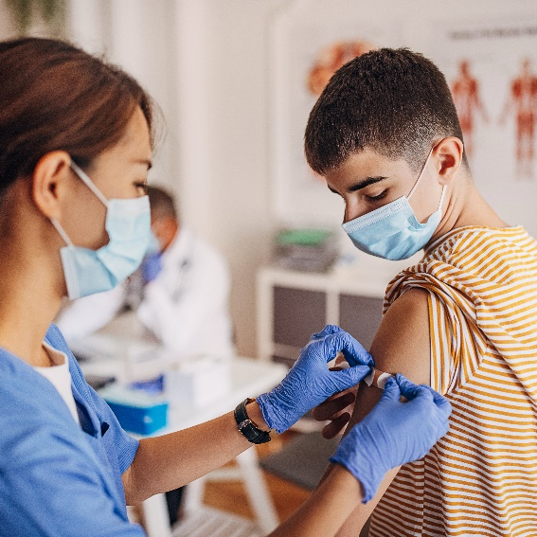
Personal Hygiene Throughout Puberty
Created by: Child Health Team
Created: November 2019
Updated: April 2022
Notes:
This presentation covers the Human Development and Sexual Health section D2.4 of the Grade 4 Ontario Health and Physical Education Curriculum.
Hygiene practices are individual and personal choices, encourage students to talk to parents or a trusted adult about the changes of puberty and hygiene practices.
To provide an inclusive environment for all students, regardless of their gender identity, we use the names of body parts and hormones to discuss physical differences rather than the use of gender.

Slide 2
Class Guidelines
Giggling is okay
Be respectful
Everyone is learning, ask questions!
Discuss puberty topics responsibly outside the classroom
Notes:
Ask students to contribute ideas to add to the guidelines

Slide 3
What is puberty?
Time of change from child to adult
Physical changes
Emotional changes

Slide 4
When does puberty start and why?
Puberty begins when youth are between 8-15 years old
The brain sends a signal to the reproductive organs to produce hormones
These hormones cause physical and emotional changes
Notes:
Everyone’s body is different. For example, people are different heights and have different hair colour, it is normal for not everyone to look the same.
When puberty starts and how long the process takes can vary greatly from one person to the other, which is something we don’t have control over and is completely okay.
Image source: https://pixabay.com/vectors/brain-anatomy-man-mind-people-154297/

Slide 5
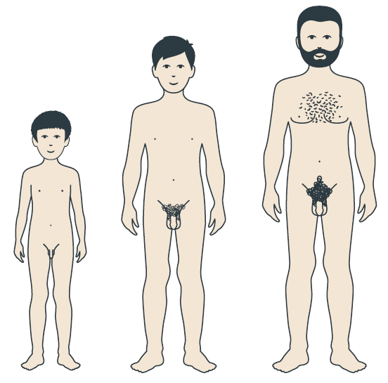
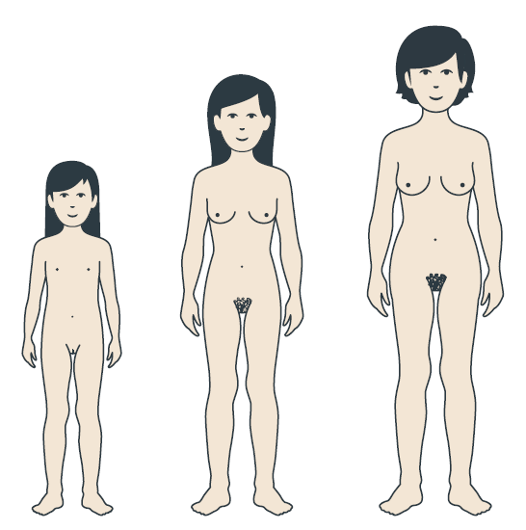
Person with a penis
Person with a vulva
Notes:
The penis and vulva are the external/visible part of the reproductive anatomy (point to penis and vulva for clarification). Many different words are used for these body parts, penis and vulva are the anatomical names.
Most changes during puberty affect everyone, however there are some changes that only happen to a person with a vulva, such as getting a period.
We will discuss periods a bit later.
Image Source: https://www.secca.org.au/ with permission

Slide 6
Hygiene and Puberty
Physical changes during puberty may change what we need to do to keep ourselves clean
Notes:
Image source: Adobe Stock-purchased

Slide 7
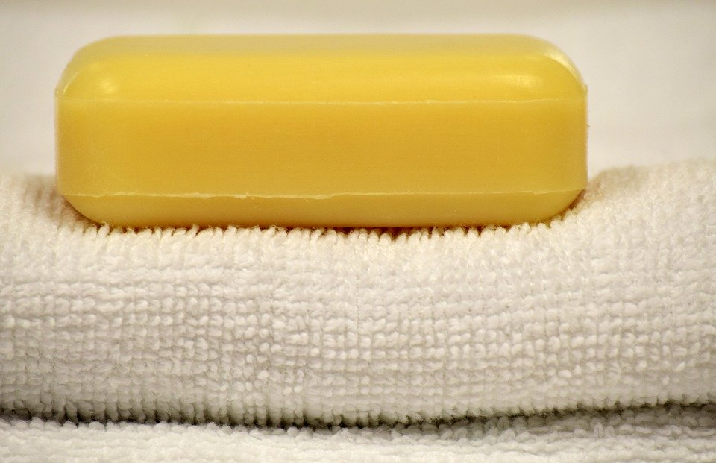
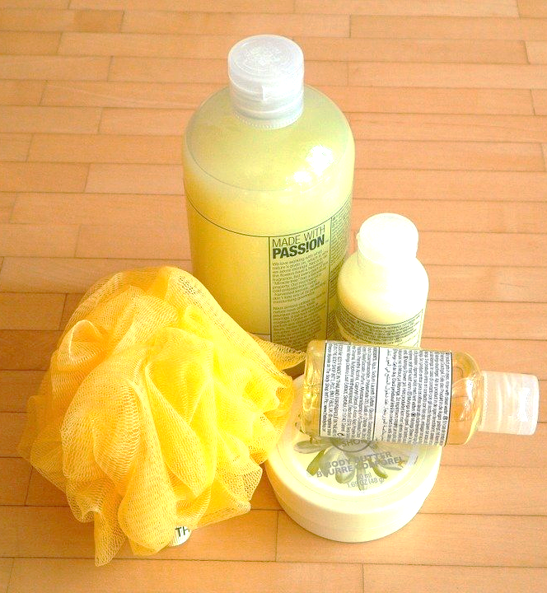
Notes:
What are these items? How do they relate to the changes during puberty?
Image source: Adobe Stock-purchased

Slide 8
Soap/Body Wash
You may want to shower or bathe more often once puberty begins.
During puberty:
Skin becomes oilier, can cause acne
Body sweats more
Body odour
Don’t pop or squeeze pimples!
Washing your face with mild soap 1-2 times a day can help with acne
Notes:
-Oilier skin can cause acne. Commonly on the face, back and chest. If acne is causing a lot of concern, speak to parent or healthcare provider about products to use
-Sweat combines with bacteria on the skin to cause body odour. Sweaty areas like genitals, underarms and feet are more likely to have odour
-It is important to note that the acceptance of body odour varies across cultures
-There are many cleansing products available (soap, body wash, bath gels), choose what works best for you

Slide 9
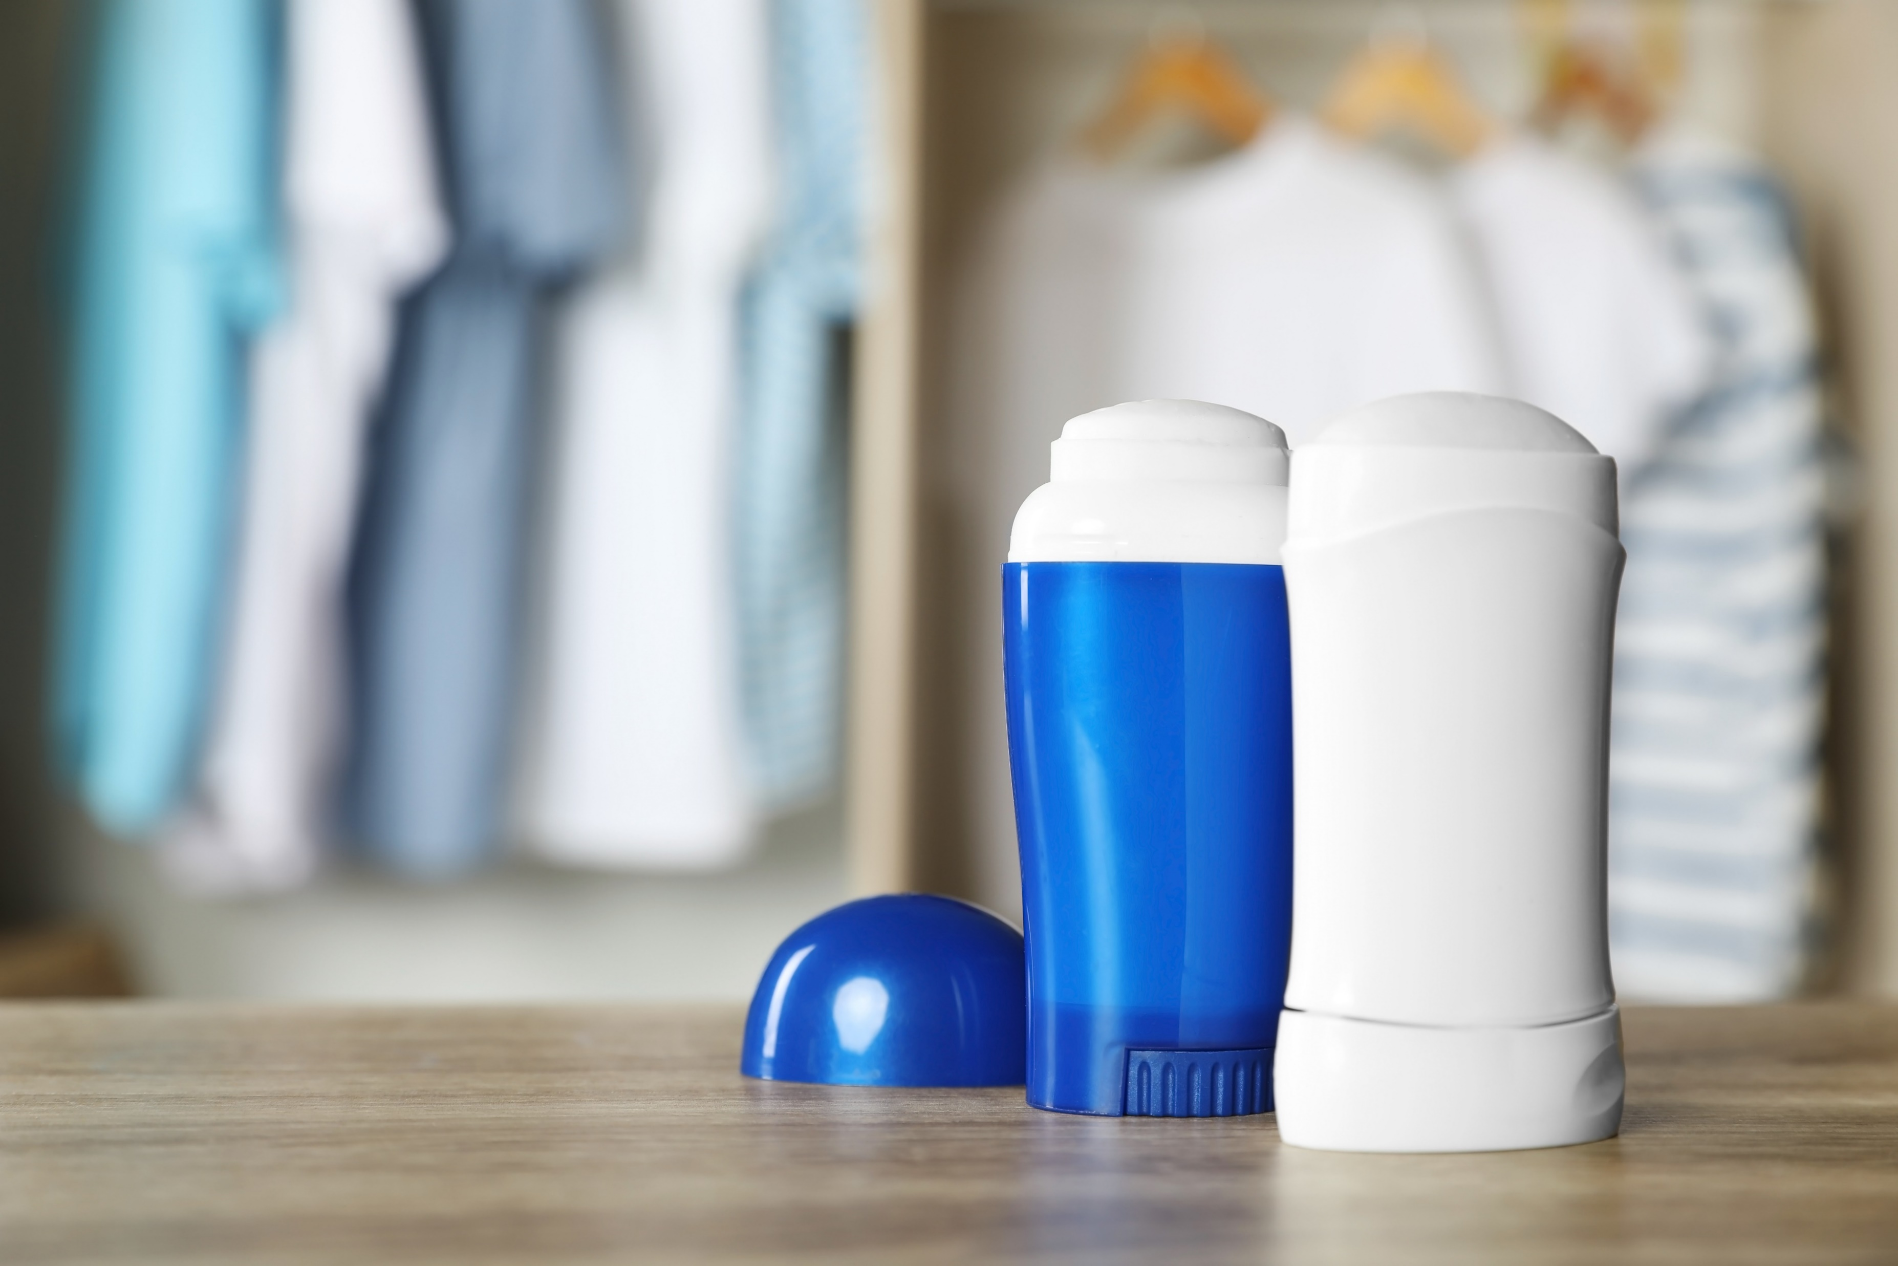
Notes:
What are these items? How do they relate to the changes during puberty?
Image source: Adobe Stock-purchased

Slide 10
Deodorant/Antiperspirant
Some people start to use deodorant/antiperspirant when puberty begins, it is applied to underarms in the morning or after showering.
Deodorant helps control odour
Antiperspirant reduces sweat
Combination products available
Notes:
-Body sprays, perfumes or colognes do not replace showers or deodorant. They can produce a strong smell that will not always cover body odours.
-Be aware of fragrance-free policies and the impact of sprays/perfumes on those around you.
-Be mindful of marketing of products e.g. Axe

Slide 11
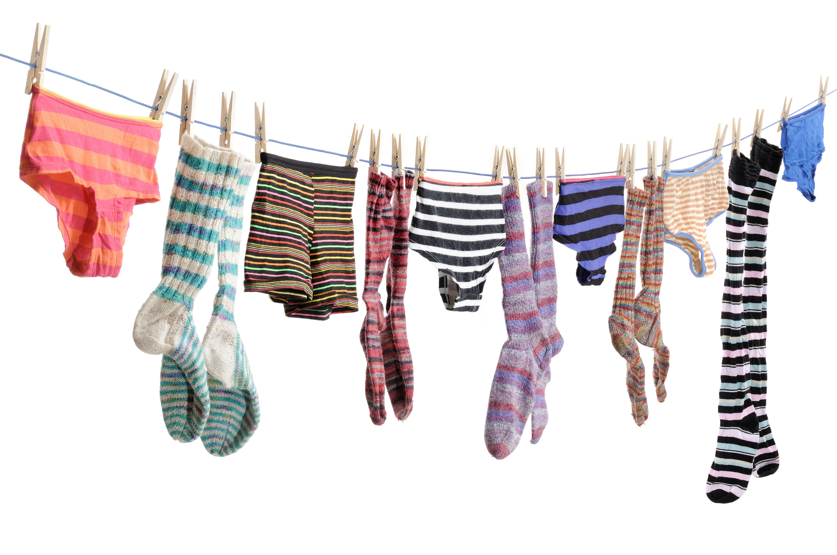
Notes:
What are these items? How do they relate to the changes during puberty?
Image source: Adobe Stock-purchased

Slide 12
Laundry
You may need to wash your clothes more often when puberty begins.
Sweat and oil stick to clothes
Bacteria cause clothes to smell when not washed regularly
Underwear, socks and shirts cover the sweatiest parts.
Make sure they’re fresh every day!

Slide 13
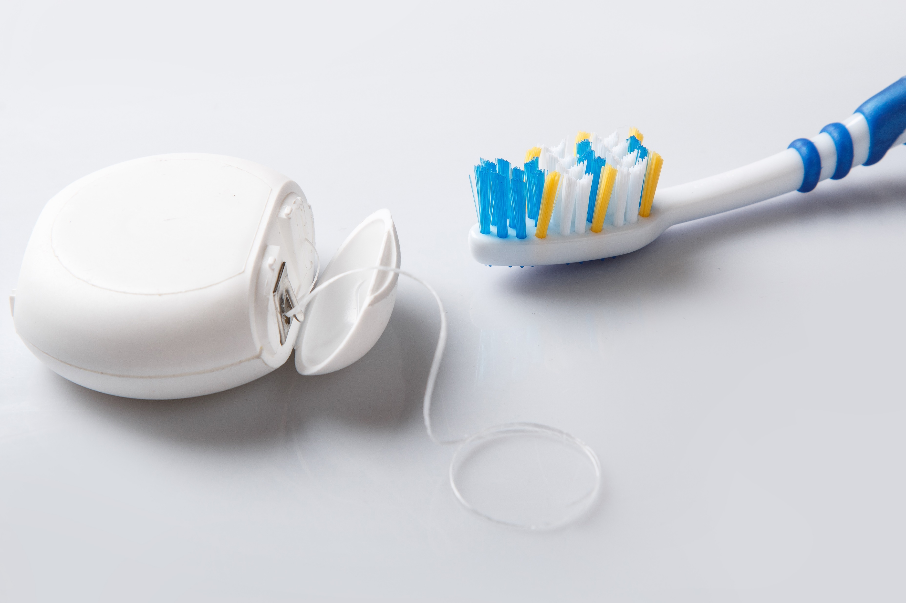
Notes:
What are these items? How do they relate to the changes during puberty?
Image source: Adobe Stock-purchased

Slide 14
Toothbrush and Dental Floss
Brush your teeth for 2 minutes 2 times a day.
Prevent cavities
Get rid of bacteria that causes bad breath
Use a pea-sized amount of toothpaste
Don’t forget to floss every day too!
Notes:
Good oral hygiene is important throughout life, not just at puberty!
-If unable to brush teeth after lunch at school, swish and spit with water to reduce food debris
-Replace toothbrushes every 3 months-don’t share toothbrushes
-mouthwash is only for children older than 6, does not replace brushing and is a personal choice

Slide 15
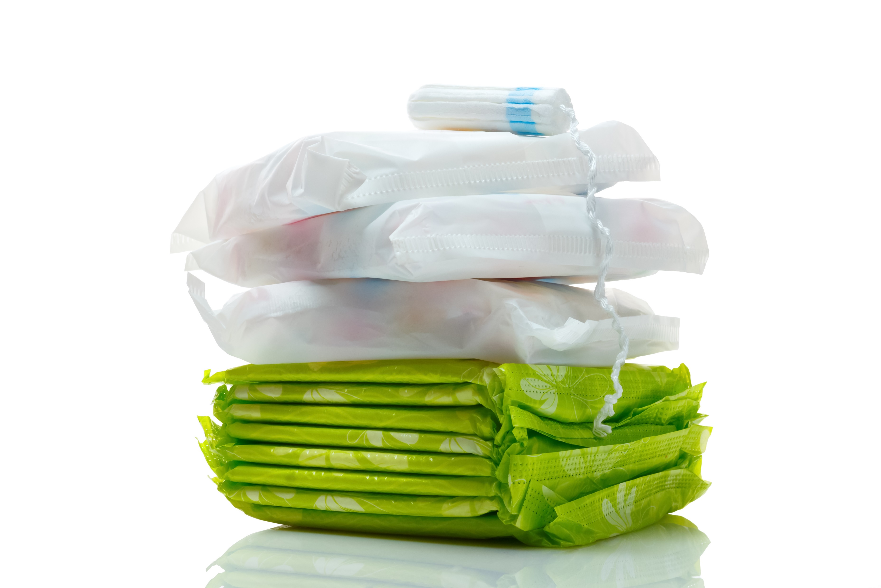
Notes:
What are these items? How do they relate to the changes during puberty?
Image source: Adobe Stock-purchased

Slide 16
Menstrual Products
What is menstruation (a period)?
A person who has a vulva and a uterus will begin to get a period
Blood and tissue leave the body through the vagina
Happens about every month
Lasts 2-7 days
Notes:
-Menstruation starts during puberty, may not happen every month at first (every 21-45 days)
(For more detailed information on the menstrual cycle and a diagram of the uterus, see our Puberty and Reproduction presentation)

Slide 17
Menstrual Products
Used to catch blood and discharge keeping underwear clean
Pantyliners/Menstrual pads
Tampons
Menstrual cups
Menstrual underwear
All menstrual products need to be changed every couple hours to prevent infections
Notes:
Pantyliner: thin pad used for discharge or when expecting period
Menstrual pad: sticks to inside of underwear during a period
Tampon: inserted in the vagina to catch blood and discharge.
Menstrual cup: reusable, flexible cup that is placed inside the vagina to catch blood and discharge, emptied every 4-12 hours
Menstrual underwear: reusable, absorbent underwear used in addition to or instead of other menstrual products.
The type of menstrual product used is a personal choice.

Slide 18
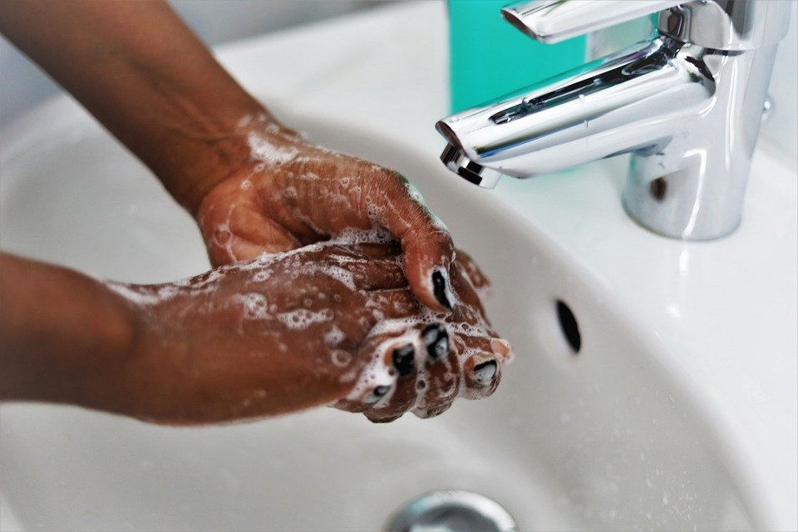
Notes:
What does this image show? How does it relate to the changes during puberty?
Image source: https://pixabay.com/photos/corona-hand-washing-virus-covid-19-5069862/

Slide 19
Handwashing
The most important thing we can do to prevent the spread of germs
When should we wash our hands?
After using the washroom
Before eating or preparing food
After sneezing or coughing
If your hands look dirty, wash them!
Notes:
Handwashing is important throughout life, not just at puberty!
Other times to wash hands:
After touching an animal
After being outside

Slide 20
Handwashing
How do we wash properly?
Turn on tap
Lather with soap for 20 seconds
Rinse with running water
Dry with clean/paper towel or hand dryer
Did you know it takes about 20 seconds to sing the ABC song?
Notes:
Hand sanitizer can be used if hands don’t look dirty and soap and water not available.

Slide 21
Where can you get more information?
Parents or other family members
Other trusted adults (teachers)
Health professionals
Notes:
Parents can be a really good source of information when it comes to changes during puberty. They can answer questions and give great advice. Students are encouraged to share what they have learned with their parents and ask a trusted adult to answer any of their questions regarding puberty.

