Slide 1
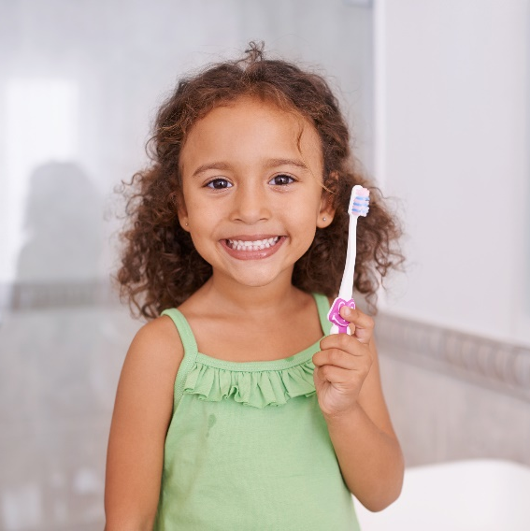
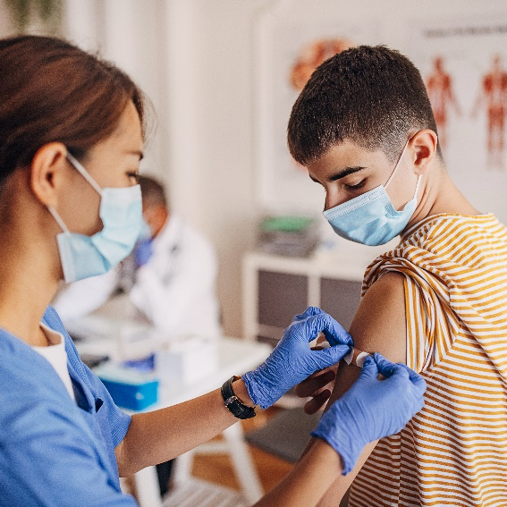
Healthy Relationships & Consent

Slide 2
What is a Healthy Relationship?
Notes:
Ask students – what is a healthy relationship? What are the characteristics?
e.g. Respect, honest, equity, consideration, commitment, good communication References:
Pixabay. (n.d.). Engagement. Retrieved from https://pixabay.com/en/engagement-love-smile-romantic-2216470/
Pixabay. (n.d.). Holding Hands. Retrieved from https://pixabay.com/en/holding-hands-couple-1149411/

Slide 3
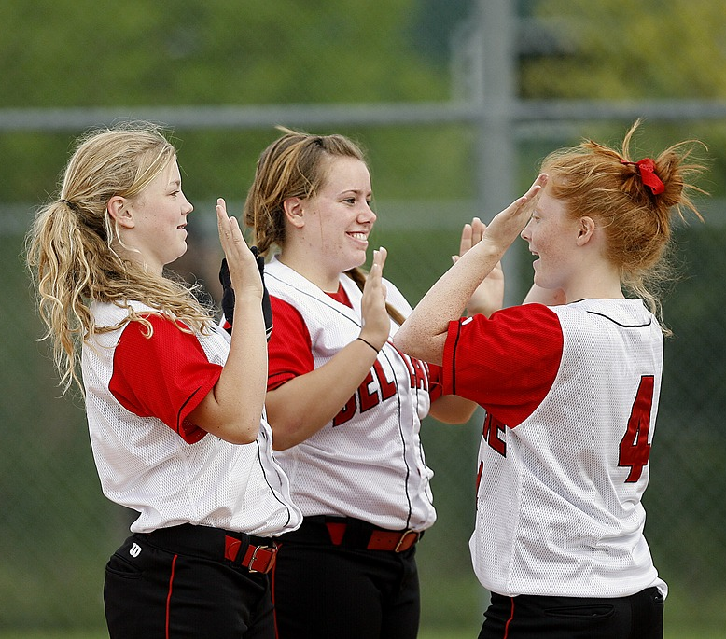
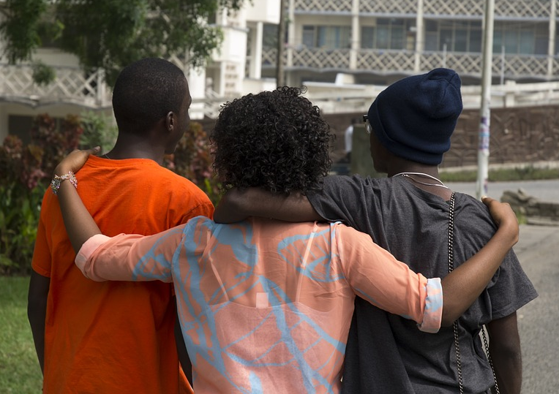
Healthy Relationships
Throughout our lives, we are involved in many different kinds of relationships.
We have relationships with parents, siblings, friends, teachers, classmates and romantic relationships
Relationships have the potential to make us happier people and add to our feelings of self-worth. These are healthy relationships.
Notes:
References:
Middlesex-London Health Unit (2017). Healthy Relationships. Retrieved from https://www.healthunit.com/healthy-relationships
Pixabay. (n.d.). Softball Girls. Retrieved from https://pixabay.com/en/softball-girls-team-mates-happy-1570671/
Pixabay. (n.d.). Friends. Retrieved from https://pixabay.com/en/friends-together-hugs-back-view-1262152/

Slide 4
Healthy Relationships
vs
Unhealthy Relationships
Your partner acts controlling or possessive
Unhealthy
Solves conflict without putting each other down
Healthy
Your partner tells you how to dress
Unhealthy
Have different opinions and interests
Healthy
Notes:
References:
Middlesex-London Health Unit. (2017). Healthy Relationships. Retrieved from https://www.healthunit.com/healthy-relationships

Slide 5
Important Characteristics of a Healthy Relationship
Characteristics | Description
Self-Awareness | Know, accept and trust yourself. In a healthy relationship you feel comfortable being yourself.
Honest Communication | Discuss the things that are important to you. Listening to your partner is also a part of good communication.
Equality | Having shared power within the relationship helps to keep the relationships safe and fair.
Notes:
References:
Kids Help Phone. (n.d.). Healthy Relationships vs. Unhealthy Relationships. Retrieved from https://kidshelpphone.ca/article/healthy-relationships-vs-unhealthy-relationships
Kids Health. (2017). Am I in a Health Relationship. Retrieved from http://kidshealth.org/en/teens/healthy-relationship.html
Middlesex-London Health Unit. (2017). Healthy Relationships. Retrieved from https://www.healthunit.com/healthy-relationships

Slide 6
Important Characteristics of a Healthy Relationship
Characteristics | Description
Respect | Each person values the other, accepts differences & understands the other person’s boundaries.
Support | Being there for your partner to listen during times of need and celebrate when good things happen in life.
Trust | Being able to count on your partner and believe that they will be honest and follow through on promises.
Notes:
References:
Kids Help Phone. (n.d.). Healthy Relationships vs. Unhealthy Relationships. Retrieved from https://kidshelpphone.ca/article/healthy-relationships-vs-unhealthy-relationships
Kids Health. (2017). Am I in a Health Relationship. Retrieved from http://kidshealth.org/en/teens/healthy-relationship.html
Middlesex-London Health Unit. (2017). Healthy Relationships. Retrieved from https://www.healthunit.com/healthy-relationships

Slide 7
Signs of Unhealthy Relationships
Trying to control your partner
Afraid of disagreeing with each other
Criticize one another in front of others
Push, shove, grab, hit or throw objects
Ridicule or call names
Notes:
References:
Middlesex-London Health Unit. (2017). Healthy Relationships. Retrieved from https://www.healthunit.com/healthy-relationships

Slide 8
Does Jealousy = Love?
No!
The source of jealousy is usually insecurity
Jealousy is about real or imagined fears
The best way to deal with jealousy is to communicate honestly with your partner
Notes:
-When someone uses jealousy to try to control what you do or where you go, this is not love it is control
-The source of jealousy is usually insecurity within the relationship
-Jealousy is about real or imagined fears (e.g. fear of being alone, fear of being embarrassed)
-Communicating honestly with your partner is the best way to deal with jealousy
References:
Middlesex-London Health Unit. (2017). Healthy Relationships. Retrieved from https://www.healthunit.com/healthy-relationships
Question Mark. Retrieved from canva.com

Slide 9
Know your Relationship Rights
Healthy relationships are honest, respectful, and responsible
Partners don’t pressure each other to go against their personal values
Both people involved feel good about themselves.
By believing in your right to be treated well, you are taking important steps to developing healthy relationships.
Notes:
References:
Middlesex-London Health Unit. (2017). Healthy Relationships. Retrieved from https://www.healthunit.com/healthy-relationships
Pixabay. (n.d.). Checklist. Retrieved from https://pixabay.com/en/checklist-clipboard-questionnaire-1622517/

Slide 10
Dealing with Arguments
It’s okay to disagree from time to time, but it is important to fight fair when arguing
How to Fight Fair:
Talk Calmly
Explain your feelings
Discuss what you would like to change
Cool off
Notes:
How to Fight Fair:
-Calmly talk about what is bothering you
-Explain how you feel without accusing others
-Discuss what you would like to change
-Cool off- take a break if you find yourself getting angry
References:
Kids Help Phone. (n.d.). Healthy Relationships vs. Unhealthy Relationships. Retrieved from https://kidshelpphone.ca/article/healthy-relationships-vs-unhealthy-relationships
Pixabay. (n.d.) Character. Retrieved from https://pixabay.com/en/character-back-to-back-male-woman-1797362/

Slide 11
Dating Violence
Violence is NOT a normal part of a relationship
Physical fighting is never OK
Types of Violence/Abuse:
Emotional
Physical
Sexual

Slide 12
What is Consent
Willingly giving permission, through words or actions, for something to happen
Consent must be informed and explicitly stated
Silence is not consent
If an individual does not say “YES”, it must be assumed that she/he is saying “NO”
Notes:
References:
The Society of Obstetricians and Gynaecologists of Canada. (n.d.). What is Consent. Retrieved from http://www.sexandu.ca/consent/what-is-consent/
Images from canva.com

Slide 13
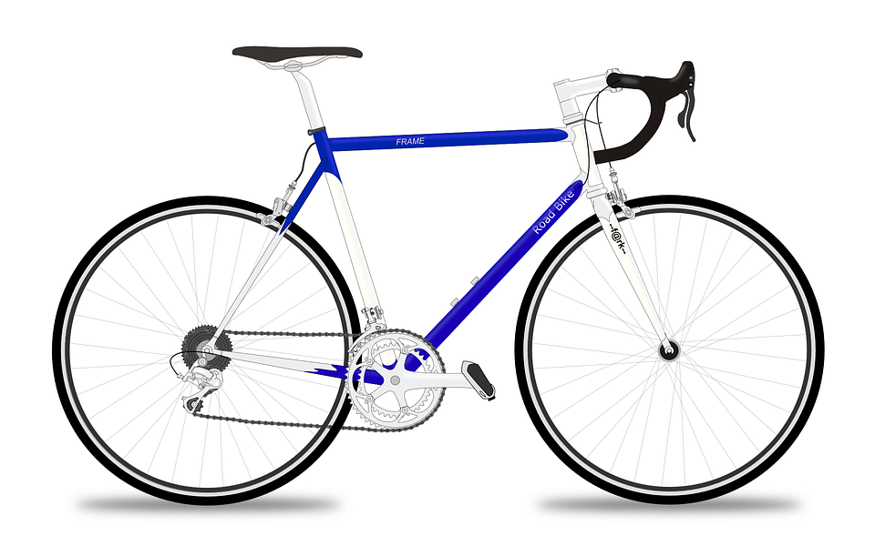
Consent is SIMPLE! It’s as easy as…
Riding a bike
Tea
Notes:
References:
Western University. (2015). Cycling Through Consent [Video File]. Retrieved from https://www.youtube.com/watch?v=-JwlKjRaUaw
Thames Valley Police. (2015). Tea and Consent. Retrieved from https://www.youtube.com/watch?v=pZwvrxVavnQ
Pixabay. (n.d.). Racing Bike. Retrieved from https://pixabay.com/en/racing-bicycle-racer-racing-bike-161449/
Pixabay. (n.d.). Coffee. Retrieved from https://pixabay.com/en/coffee-cup-drink-food-hot-156158/

Slide 14
Sexual Assault
Sexual assault is any type of sexual activity in which one person does not consent
Sexual assault can range from unwanted touching, to kissing, to intercourse
Notes:
Who experiences Sexual Assault?
-Anyone can potentially be a victim of sexual assault, regardless of age, race, social class, religion or occupation.
Statistics show that the majority of sexual assaults are committed by men against women or children.
Who commits sexual assault?
-Women face the greatest risk of sexual assault from men they know, not strangers.
Who is responsible for sexual assault?
-People who commit sexual assaults are responsible for these crimes, not the victims.
What a woman wears, where she goes, what she drinks or who she talks to does not mean she is inviting sexual assault or giving up her right to say no.
How can you help a friend that has been sexually assaulted?
-Listen to them
Believe them
Let them know you care. Example- “ I’m sorry this happened to you”
Reassure them that is it not their fault
Do not blame
Let them control what they do next
Let them know they are not alone
What to do if you have been sexually assaulted?
Don’t blame yourself
Find a safe environment to call a parent, friend or the police
Don’t wash or change your clothes as this may destroy evidence
Call your local sexual assault treatment centre
Get medical attention to determine risk of STI’s and pregnancy
Resources in our Community:
Regional & Sexual Assault Treatment Centre
Anova (previously Sexual Assault Centre London)
London Abused Women’s Centre
Women’s Community House
Women’s Rural Resource Centre –Strathroy ON
Police- Call ‘911’
References
Middlesex-London Health Unit. (2017). Sexual Assault. Retrieved from https://www.healthunit.com/sexual-assault

Slide 15
Test Your Knowledge
Notes:
References:
Pixabay. (n.d.). Exam. Retrieved from https://pixabay.com/en/exam-scientific-experiment-2428208/

Slide 16
Is it okay to have sex with someone if they are drunk?

Slide 17
FALSE
A person cannot consent if she/he is drunk or high, threatened, or coerced, has certain disabilities, or is in a relationship of trust with the offender.
Notes:
References:
The Society of Obstetricians and Gynaecologists of Canada. (n.d.). What is Consent. Retrieved from http://www.sexandu.ca/consent/what-is-consent/

Slide 18
Does someone’s body language or actions (i.e. removing clothing, initiating intimate touch) imply consent?

Slide 19
FALSE
Consent must be expressed willingly through words or actions BUT can be revoked at any time! At any time during intimacy one or both partners can change their mind!
Notes:
References:
The Society of Obstetricians and Gynaecologists of Canada. (n.d.). What is Consent. Retrieved from http://www.sexandu.ca/consent/what-is-consent/

Slide 20
When Relationships End
Remain respectful
Be Truthful
Talk to your partner face-to-face (avoid breaking-up over texting or social media)
Explain your feelings
Notes:
Relationships can end for many reasons. When they end, it’s important to remain respectful.
References:
Kids Health. (2014). How to Break up Respectfully. Retrieved from http://kidshealth.org/en/teens/break-up.html?WT.ac=t-ra#
Pixabay. (n.d.). Broken Heart. Retrieved from https://pixabay.com/en/broken-heart-fractured-heart-1967751/

Slide 21
Questions?

