Slide 1
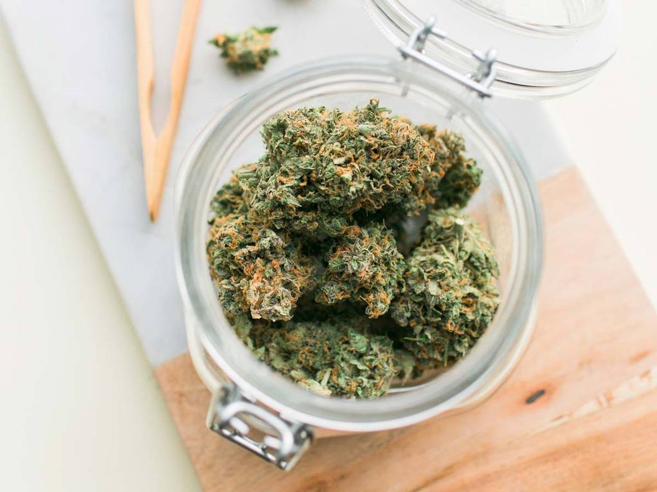
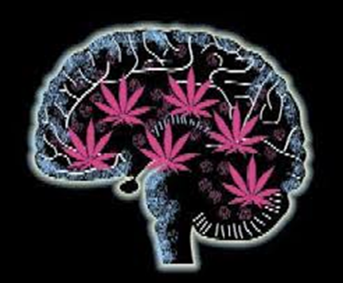
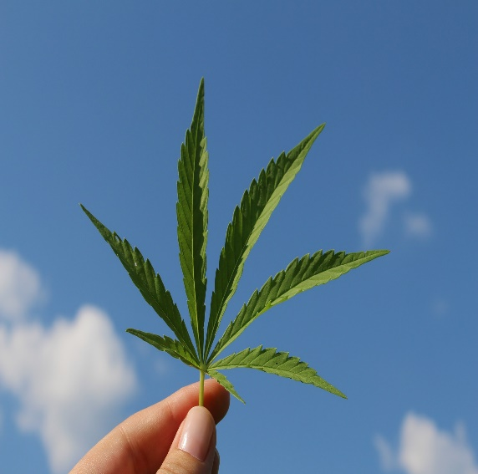
Curious about cannabis

Slide 2
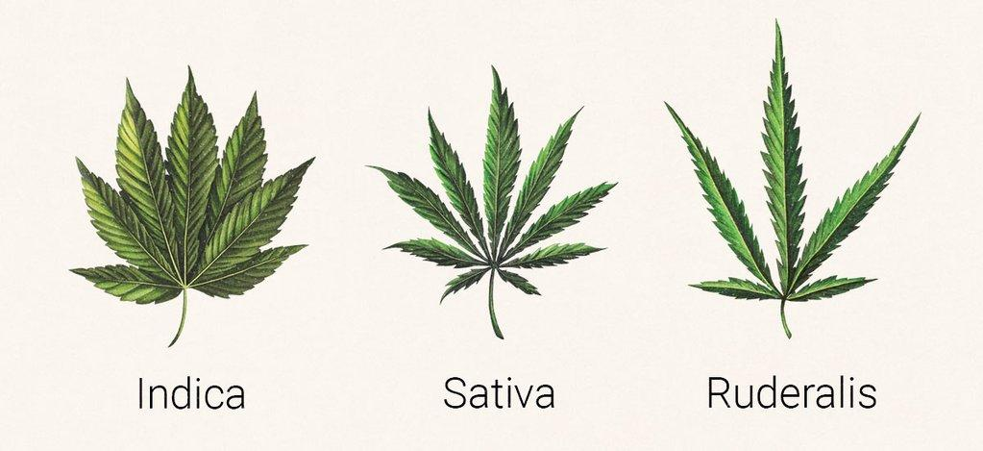
What is it?
Notes:
Like most drugs- cannabis starts off as a plant.
There are three different types of cannabis plants.
Indica, Sativa and Ruderalis.
They all have different amounts of chemicals called cannabinoids- the ones we know most about are THC (delta-9-tetrahydrocannabinol) and CBD (cannabidiol). When consumed, they work by binding to cannabinoid receptors located in our brain and body like a lock and key (the cannabinoid being the key and the receptor being the lock). Because cannabinoid receptors are present throughout the brain and body, activating them (opening the lock) can influence a broad range of psychological and physiological processes.
THC is responsible for the psychoactive effect, or “high,” and the associated physical impairment. Unlike THC, CBD does not generally produce a “high.”
References:
1 CCSA website: http://www.ccsa.ca/Eng/topics/cannabis/Pages/default.aspx
2 Ontario Cannabis Store Website. Retrieved April 4, 2019 from: https://ocs.ca/blogs/cannabis-anatomy/cannabis-strains
Picture Source: https://ocs.ca/blogs/cannabis-anatomy/the-cannabis-plant-1

Slide 3
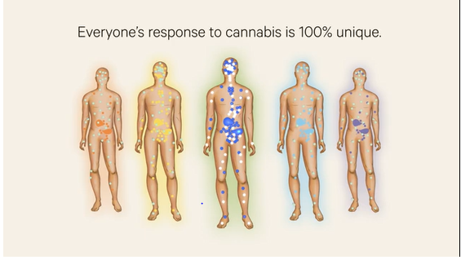
ENDOCANNABINOID SYSTEM & Cannabis
How Cannabis impacts you will vary depending on:
Individual’s physiology
Age
Type of product/strain: (THC vs. CBD)
How often and how much is consumed
Notes:
Our bodies have something called the endogenous cannabinoid system, or endocannabinoid system - with receptors found all over the body. This system plays a role in brain cell growth and controlling brain functions such as appetite, motor activity, motivation, mood, stress response, immune system activity, reward, learning and memory. It is understood that our body responds to some of the chemicals in cannabis (e.g. THC and CBD) through this system of receptors. Consuming cannabis regularly can interfere with the normal functioning of the body’s endocannabinoid system by “hijacking” it and disrupting the regulatory role the system plays. This can cause changes to how your brain and body functions.
Everyone’s physiological makeup is different, and the endocannabinoid system’s receptor site locations and the number of sites can vary from person to person. That is why the same strain of cannabis can affect people differently. Additional factors that contribute to the potential differences in effect can also include the genetics, gender, current health, personality and age of the individual. That does not include the differences in the actual cannabis used, so effects can also depend on amount of THC and CBD in the product, type of product, how it is consumed and how often it is consumed.
Because there are so many different factors that can impact your experience it is possible people can experience something different than what they may have expected. The immediate effects of cannabis can be both pleasant and unpleasant:
Some of the Pleasant effects reported are:
To relax
to feel happier, more social or more energetic
to become more focused, creative or productive
to increase appetite or arousal
And some of the Unpleasant effects reported are:
an inability to concentrate
memory problems
anxiety, panic or paranoia
disorganized thoughts
dizziness or hallucinations
reduced reaction time and
Sleepiness
1 Ontario Cannabis Store: https://ocs.ca/blogs/how-cannabis-works/endocannabinoid-system
2 Health Effects of Cannabis. (2017) Government of Canada. Retrieved online April 4, 2019 from: https://www.canada.ca/content/dam/hc-sc/documents/services/campaigns/27-16-1808-Factsheet-Health-Effects-eng-web.pdf
Photo Source: https://ocs.ca/blogs/how-cannabis-works/endocannabinoid-system

Slide 4
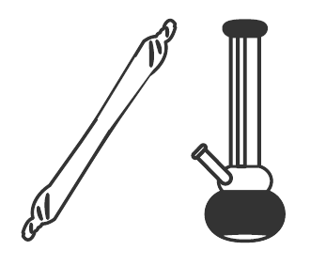
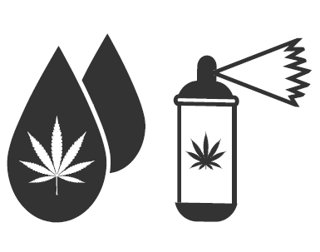
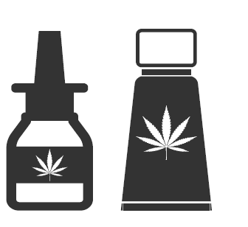
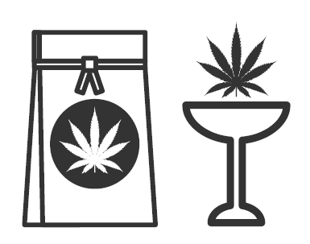
How is it used?
Notes:
INHALATION -
Inhalation is the most common way people have traditionally consumed cannabis. The onset of effects is rapid with most people feeling a “high” within minutes of inhalation. Common examples of delivery methods using inhalation are: hand pipe, bong, vaporizer, joint and hookah.
ORAL-MUCOSAL -
The product (most commonly a tincture) is applied under the tongue or sprayed into the mouth and absorbed through the oral-mucosal lining.
INGESTION -
Ingesting cannabis is most commonly in the form of a food or beverage item that was created using a fat or oil infused with cannabis that was then heated to ensure the cannabinoids are active when consumed. Edibles include any food or drink that contains cannabis.
TOPICAL -
Topical cannabis products are applied and absorbed through the skin using a thick oil extract that contains active cannabinoids. The effects of the cannabinoids are generally localized and use of the product is generally not to confer intoxicating effects, but to provide localized relief from pain or inflammatory conditions (some exceptions apply).
Reference:
Canadian Public Health Agency. (2019). Cannabasics. Retrieved from: https://www.cpha.ca/cannabasics

Slide 5
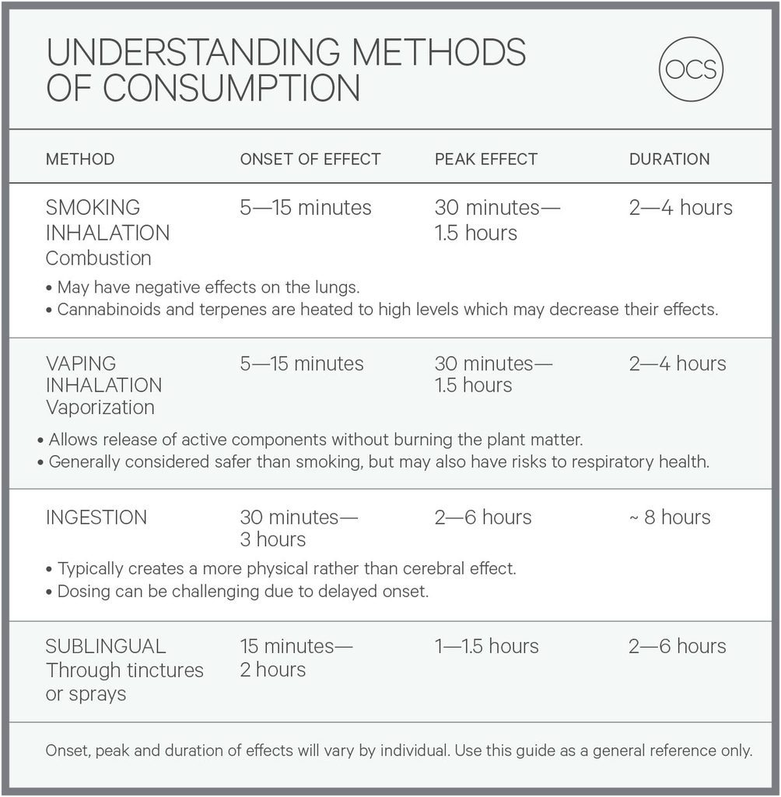
Notes:
When smoked– it usually has immediate effects within minutes and can last 2-4 hours. Where as if you eat cannabis- it takes anywhere from 30 minutes to 3 hours to have effects and can last for 8-12 hours.
This is all related to how fast it can reach your brain through your blood system- chemicals from the smoke in your lungs reach the brain faster, while edibles have to be digested in your intestines first. (Ashton, 2001)
Sources: Ashton, C. H. (2001). Pharmacology and effects of cannabis: a brief review. British Journal of Psychiatry, 178, 101–106.
Dabbing: https://www.leafly.com/news/cannabis-101/what-are-cannabis-dabs-and-benefits-of-dabbing-marijuana & https://www.leafly.com/news/cannabis-101/how-to-dab-cannabis-concentrates
Graph: OCS Website: https://ocs.ca/blogs/facts-about-cannabis-consumption/methods-of-consumption

Slide 6
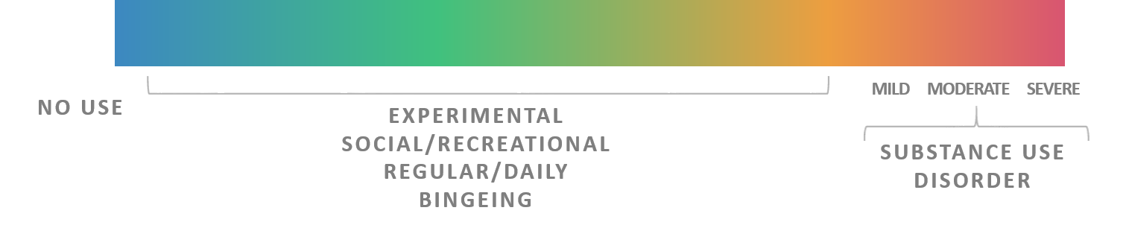
Substance use Continuum
When does substance use become a problem?
No Problems
Minimal Problems
Serious Problems
Many Problems
Notes:
People will vary in their cannabis consumption patterns, ranging from:
Never consuming cannabis (abstinent)
Experimental Use: has tried a substance one or several times. Use can be motivated by curiosity about the drug effect and peer influence
Occasional consumption with very little negative effects - use is irregular, usually confined to special occasions (holidays, birthdays etc.) or when opportunities present themselves dir3ectly. Availability, accessibility and affordability influence use
Regular consumption with very little negative effects – use has a predictable pattern, which may entail frequent or infrequent use. The user actively seeks to experience the drug effect, or to participate in the drug-taking activities of the peer group. Usually they feel in control of the drug use (i.e. can take it or leave it)
Regular consumption accompanied by difficulties in their lives due to consumption (around 10% of cannabis consumers) – Dependence: use is regular and predictable, and usually frequent. The user experiences a physiological and/or psychological need for the drug. They feel out of control in relation to its use, and will continue to use despite adverse consequences. Drugs often are used when alone, and daily activities may be planned around drug use.
People may move along the continuum of cannabis consumption forwards and backwards, ranging from abstinence to regular consumption over time. Why might someone move to different stages: see parents doing it, easy access, friend talking about having tried it, curiosity, see teens using on TV, see it as the “norm” to do at parties, to fit in, and/or parents allow within the home. Decreasing the potential harms associated with cannabis consumption may involve moving down the continuum and reducing consumption, or may involve changing the method of consumption.

Slide 7
Get the Facts!

Slide 8

You hear…
It’s natural. If it comes from a plant, it must be safe
When actually…
Cannabis smoke has cancer-causing toxins that can cause damage to the lungs
Notes:
When looking at the health impacts from cannabis- Long term cannabis smoking causes issues with respiratory symptoms and frequent bronchitis. When it comes to cannabis or tobacco → smoke is smoke and it is all harmful.
Reference:
Middlesex-London Health Unit. (2016). Marijuana- myths and facts. Retrieved from https://www.healthunit.com/myths-and-facts

Slide 9
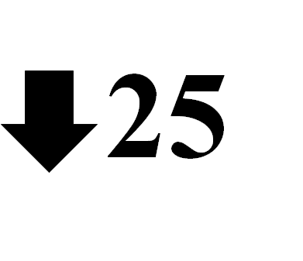
You hear…
Cannabis is safe for anyone, no matter what age.
When actually…
Youth are at the greatest risk of the negative health effects of cannabis because the brain continues to develop until age 25
Notes:
Reference:
Canadian Centre on Substance Use and Addiction. (2015). The effects of cannabis use during adolescents. Retrieved from: https://www.ccsa.ca/sites/default/files/2019-04/CCSA-Effects-of-Cannabis-Use-during-Adolescence-Report-2015-en.pdf

Slide 10
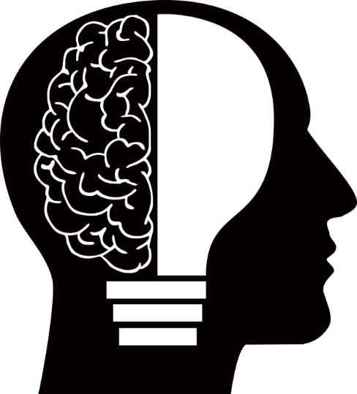
You hear…
Cannabis will help me focus in school
When actually…
Cannabis use can cause decreased concentration, poor memory, and impair learning
Notes:
The regions of the brain that undergo the most fine-tuning during the teenage years are those responsible for decision making, judgment, emotional regulation planning and problem solving, and these regions are potentially most susceptible to cannabis when they are not yet fully developed. Key among these regions is the prefrontal cortex, which is most susceptible to the neurotoxic effects of cannabis when it is not yet fully developed.
Without a well-developed prefrontal cortex, a teen has to rely on other brain regions for cognition, namely the limbic system, which is responsible for emotions. This reliance allows the “emotional” brain to control behaviour, rather than enlisting the help of the prefrontal cortex or the “thinking” brain. This control of behaviour by the emotional brain can lead to increased risk-taking behaviour, poor decision making and inferior reasoning ability.
Cannabis intoxication has been linked to deficits in attentional focus, information processing, motor coordination and reaction time, while long-term regular use that starts in adolescence has been found to be associated with impairments in attention, memory and verbal learning. In some contexts, the long-term cognitive impairments that result from regular cannabis use have been reversed, but this appears less likely for heavy use that begins in adolescence.
As the acute effects of cannabis can impact learning and schoolwork completion, youth who use cannabis regularly are more likely to drop out of high school and, in turn, less likely to pursue post-secondary education.
Reference:
Canadian Centre on Substance Use and Addiction. (2019). Clearing the smoke on cannabis: Regular use and cognitive functioning. Retrieved from: https://www.ccsa.ca/clearing-smoke-cannabis-regular-use-and-cognitive-functioning

Slide 11
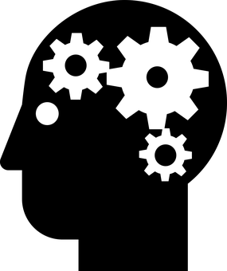
You hear…
Cannabis improves my mental health
When actually…
Teens who use cannabis are at an increased risk for psychosis, depression and anxiety disorders
Notes:
Psychosis: There is a substantial amount of research that indicates that adolescents and young adults who use cannabis are more likely than non-users to develop psychotic symptoms and/or schizophrenia, and this likelihood increases
with more frequent use and/or when there is a family or personal history of psychotic disorders. While this risk is pronounced among individuals with genetic susceptibility to psychosis and schizophrenia, the relative risk of psychosis remains even among individuals without pre-existing vulnerability.
Depression:
Several meta-analyses have examined whether cannabis use leads to developing depression, within several months or many years following the initiation of cannabis use. Results from these analyses indicate that cannabis use is associated with increased risk of developing depression. However, in the general population, the risk is relatively low, especially after accounting for confounding variables, including premorbid depression, alcohol and other substance use, age, sex, ethnicity and education. Cannabis use can increase the risk of suicidality even in the absence of a pre-existing condition.
This comorbidity does not mean that one causes the other, and establishing causality or directionality is difficult for many reasons. Three main scenarios contribute to the comorbidity between cannabis use and mental illness and the evidence for each scenario varies for different mental disorders. One scenario is that cannabis use increases the risk for mental illness. This scenario is especially true for psychosis and schizophrenia, and to a lesser extent for depression. Second, some mental disorders themselves might increase the risk for regular cannabis use. For instance, social anxiety disorder might increase the risk for developing problematic cannabis use. The third scenario is that cannabis use and mental illness are both influenced by overlapping genetic and environmental factors.
The impact of cannabis use on mental health outcomes varies among individuals and across different disorders. As an example, one individual’s cannabis use might be associated with minimal risk for psychosis or schizophrenia, but instead significantly increases their risk of developing depression or an anxiety disorder. For another individual, the combination of risk factors across mental disorders might differ.
Reference:
Canadian Centre on Substance Use and Addiction. (2019). Clearing the Smoke on Cannabis: Regular Use and Mental Health. Retrieved from:
https://ccsa.ca/sites/default/files/2019-08/CCSA-Cannabis-Use-Mental-Health-Report-2019-en_0.pdf

Slide 12



You hear…
You can’t get addicted to Cannabis
When actually…
1 in 6 people who use cannabis during their teens will develop a cannabis use disorder
Notes:
The path to cannabis use disorder (addiction) is individual. Two people who use the same method of consumption, at the same frequency, with the same potency of product, may result in one person developing dependence and the other person experiencing minimal harms. Addiction looks different for each person.
The likelihood of developing cannabis use disorder (addiction) depends upon 4 factors:
Length and intensity of consumption: longer, more intense consumption increases risk
Potency of the product: consuming high levels of THC is more addictive
Individual factors: genetic or individual vulnerabilities, sch as personality or experiences of trauma
Age of initiation: people who begin to consume cannabis at a young age (under 16 years old) at a high frequency are at greater risk
Close to 1 in 10 people who use cannabis will develop an addiction to it, and this rises to about 1 in 6 for people who started using cannabis as a teenager.
References:
Canadian Centre on substance Abuse. (2015). The effects of cannabis use during adolescence. Retrieved from http://www.ccsa.ca/Resource%20Library/CCSA-Effects-of-Cannabis-Use-during-Adolescence-Report-2015-en.pdf
Canadian Public Health Association. (2018). Cannabasics. Retrieved from https://www.cpha.ca/cannabasics

Slide 13
Cannabis Use Disorder
Does the person have two of the following:
The substance is taken in larger amounts or over a longer period than was intended.
There is a persistent desire or unsuccessful effort to cut down or control use of the substance.
A great deal of time is spent obtaining, using or recovering from the substance
Craving, or a strong desire or urge to use the substance.
Recurrent use of the substance results in a failure to fulfill obligations at work, school, or home.
Continued use of the substance despite having persistent or recurrent social or interpersonal problems caused or exacerbated by the effects of its use.
Important social, occupational, or recreational activities are given up or reduced because of use of the substance.
Recurrent use of the substance in situations in which it is physically hazardous.
Use of the substance is continued despite knowledge of having a persistent or recurrent physical or psychological problem that is likely to have been caused or exacerbated by the substance.
Tolerance, as defined by either of the following:
  A need for markedly increased amounts of the substance to achieve intoxication or desired effect.
  A markedly diminished effect with continued use of the same amount of the substance.
  Withdrawal, as manifested by either of the following:
  The characteristic withdrawal syndrome for that substance
  The substance (or a closely related substance) is taken to relieve or avoid withdrawal symptoms.
Notes:
Cannabis Use Disorder, also known as an addiction to cannabis.

Slide 14
You hear…
You can’t overdose from cannabis
When actually…
Severe nausea or vomiting
Increased heart rate
Anxiety
Psychosis
Panic attacks
Seizures
Taking too much cannabis can result in an overdose which can impact your body and cause symptoms such as:
Notes:
“Can you overdose?”
Can you die? Overall, there isn’t evidence that reports cannabis as the direct cause of overdose death. However, since your judgment is impaired, decisions you make while intoxicated from cannabis can result in serious injury or death (e.g. driving, swimming after using cannabis that could result in a crash, drowning etc).
Can you overdose? Yes you can experience a cannabis overdose. An overdose is when someone uses a higher/larger amount of a drug than what is normally used. This can be overwhelming for their body and result in many different symptoms depending on the drug. Overdoses/Poisonings from accidental ingestion in children is considered more serious because it can impact their ability to breath on their own. The younger you are the worse the impact can be.
Sometimes people go to the hospital because of how the overdose is impacting their body.
Looking at other jurisdictions that have legalized cannabis it has become apparent that there needs to be caution in having cannabis around children. It has been found that the greater availability of cannabis in Colorado has led to a rise in children accidentally consuming cannabis. In the five years preceding the legalization of medical cannabis, the Children’s Hospital of Colorado reported zero cases of accidental cannabis ingestion. In the two years after legalization, it reported 14 cases. How cannabis effects children and adults is very different. If a child were to ingest cannabis you may see effects such as: sleepiness, inactivity, unresponsiveness and the most serious being inability to breath properly. In the event that a child consumes cannabis.
If someone you know has a bad reaction, stay with them while calling the Poison Control at 1-800-268-9017. If it seems severe, call 911 immediately
References:
Health Canada. (2016). Consumer Information – Cannabis. Retrieved from: https://www.canada.ca/en/health-canada/services/drugs-medication/cannabis/licensed-producers/consumer-information-cannabis.html
GS Wang, G Roosevelt, KJ Heard. Pediatric marijuana exposures in a medical marijuana state. JAMA Pediatr. 2013; 167(7):630-633.

Slide 15
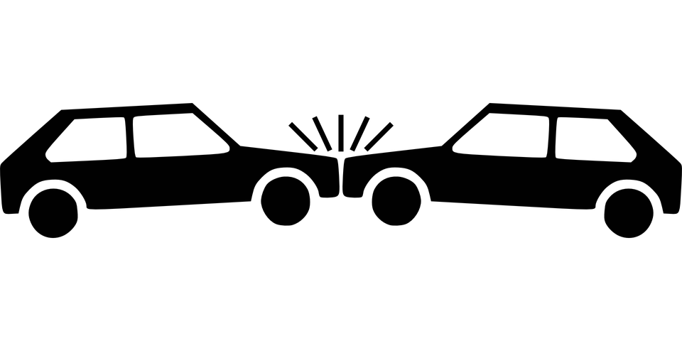
You hear…
It is safe to drive after using cannabis
When actually…
Users are 2x more likely to have a car crash while driving impaired
Notes:
As for the increased risk of motor vehicle crashes. Cannabis impairs the cognitive and motor abilities necessary to drive and doubles crash risk. This would include performance deficits in tracking, reaction time, visual function, concentration, short-term memory and divided attention. Research on youth perceptions has shown that even though youth understand the risks of cannabis use and driving, they still falsely believe that it is driver dependent.
Keep your record clean, because driving high can lead to a DUI. Just like driving drunk, driving high is illegal. Not only could it land you a DUI, but it could also seriously hurt you and other people on the road. DUIs are also expensive and can cost thousands of dollars in legal fees.
References:
Canadian Centre on Substance Use and Addiction. (2017). Clearing the smoke on driving – An update. Retrieved from: https://www.ccsa.ca/clearing-smoke-cannabis-cannabis-use-and-driving-update
Colorado Department of Public health and Environment. (n.d.). Youth and Marijuana. Retrieved from: https://responsibilitygrowshere.com/youth-and-marijuana

Slide 16

You hear…
Everyone uses cannabis
When actually…
81% of youth in grades 9-12 report not having used cannabis in the past year
Notes:
Reference
2017 OSDUHS report

Slide 17

You hear…
Police can’t tell if I'm high
When actually…
The police have the authority, ability, and tools to determine if you are impaired by illegal drugs
Notes:
Police services have officers who are trained as Drug Recognition Experts (DRE) and in Standard Field Sobriety Testing (SFST) giving them the authority and tools needed to detect and evaluate drug-impaired drivers. The number of officers trained as DREs and in SFST is increasing and all frontline officers are trained in drug-impaired driving detection.
Drug Recognition Evaluation
If an officer has reasonable grounds to believe that a driver is impaired, a drug recognition evaluation may be carried out by a specially trained officer. The test helps determine if the impairment is caused by drugs. Based on the DRE evaluation, if the DRE officer believes a driver is drug-impaired, they can require the driver to provide a blood, oral fluid or urine sample. If the driver refuses to comply with any of these demands, they can be charged under the Criminal Code. If a driver fails the test, they can be immediately suspended from driving and face criminal impaired driving charges.
Reference:
London Police Service. (n.d.). Cannabis FAQs. Retrieved from: https://www.londonpolice.ca/en/crime-prevention/cannabis-faqs.aspx
Ontario Provincial Police. (n.d.). Cannabis. Retrieved from: http://www.opp.ca/index.php?id=115&lng=en&entryid=5bc63694af4f930b4262a693

Slide 18
Medicinal cannabis
Can be effective for:
For the treatment for chronic pain in adults (cannabis)
Antiemetics in the treatment of chemotherapy-induced nausea and vomiting (oral cannabinoids)
For improving patient-reported multiple sclerosis spasticity symptoms (oral cannabinoids)
Notes:
From an evidence perspective, medical cannabis has only been found to currently help with:
1. Nausea and vomiting associated with cancer chemotherapy
2. Pain and muscle spasms associated with multiple sclerosis
3. Chronic non-cancer pain (mainly neuropathic) in adults
More time is needed to research whether cannabis is effective for other types of medical conditions.
**There has not been strong evidence to support ANY medical use in youth, with the exception of early evidence regarding certain cases of severe seizure disorders. In fact, the Canadian Paediatric Society states there is insufficient evidence to support the use of medical cannabis in children and should only be considered on a case by case basis. Remind them that “evidence” on the internet can include a lot of non-factual information. Make sure they are looking at reputable sites.
References:
The National Academies of Sciences, Engineering and Medicine (2017) The Health Effects of Cannabis and Cannabinoids: Looking at the Current State of Evidence
Chapter Highlights - https://www.nap.edu/resource/24625/Cannabis_chapter_highlights.pdf
Full Report - http://nationalacademies.org/hmd/reports/2017/health-effects-of-cannabis-and-cannabinoids.aspx
There is conclusive or substantial evidence that cannabis or cannabinoids are effective:
• For the treatment for chronic pain in adults (cannabis) (4-1)
• Antiemetics in the treatment of chemotherapy-induced nausea and vomiting (oral cannabinoids) (4-3)
• For improving patient-reported multiple sclerosis spasticity symptoms (oral cannabinoids) (4-7a)
There is moderate evidence that cannabis or cannabinoids are effective for:
• Improving short-term sleep outcomes in individuals with sleep disturbance associated with obstructive sleep apnea
syndrome, fibromyalgia, chronic pain, and multiple sclerosis (cannabinoids, primarily nabiximols) (4-19)
There is limited evidence that cannabis or cannabinoids are effective for:
• Increasing appetite and decreasing weight loss associated with HIV/AIDS (cannabis and oral cannabinoids) (4-4a)
• Improving clinician-measured multiple sclerosis spasticity symptoms (oral cannabinoids) (4-7a)
• Improving symptoms of Tourette syndrome (THC capsules) (4-8)
• Improving anxiety symptoms, as assessed by a public speaking test, in individuals with social anxiety disorders (cannabidiol)
(4-17)
• Improving symptoms of posttraumatic stress disorder (nabilone; one single, small fair-quality trial) (4-20)
There is limited evidence of a statistical association between cannabinoids and:
• Better outcomes (i.e., mortality, disability) after a traumatic brain injury or intracranial hemorrhage (4-15)
There is limited evidence that cannabis or cannabinoids are ineffective for:
• Improving symptoms associated with dementia (cannabinoids) (4-13)
• Improving intraocular pressure associated with glaucoma (cannabinoids) (4-14)
• Reducing depressive symptoms in individuals with chronic pain or multiple sclerosis (nabiximols, dronabinol, and nabilone)
(4-18)

Slide 19
Have you thought about…

Slide 20
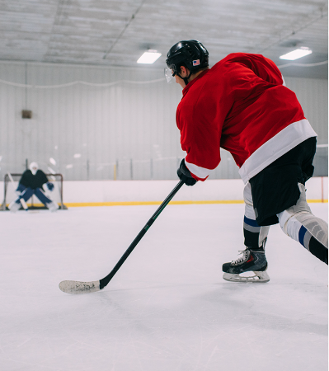
Cannabis can slow you down
By not using cannabis, you can focus on the moments that matter most.
Notes:
Whether you’re an artist or an athlete, you should know that weed can impact how well you do the things you like doing. That’s because weed can affect your reaction time and coordination. This is particularly true when it comes to doing everyday things you love like playing an Instrument, skateboarding, and even driving.
Reference:
Colorado Department of Public health and Environment. (n.d.). Youth and Marijuana. Retrieved from: https://responsibilitygrowshere.com/youth-and-marijuana

Slide 21

Cannabis can cause lower grades and exam scores
You need your brain for everything you do - from school to all of the other activities you enjoy.
Notes:
Youth who regularly use weed are more likely to have difficulty learning, memory issues and lower math and reading scores. Studies show that these effects can last weeks after using marijuana.
Reference:
Colorado Department of Public health and Environment. (n.d.). Youth and Marijuana. Retrieved from: https://responsibilitygrowshere.com/youth-and-marijuana

Slide 22
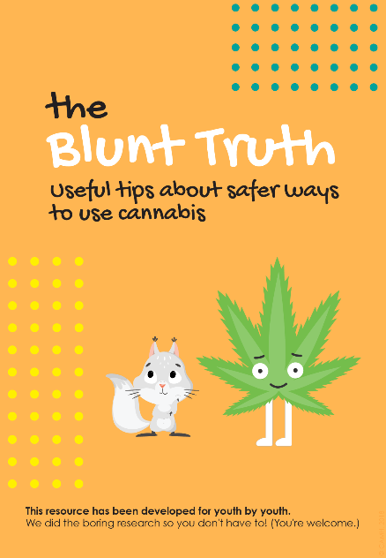
Harm reduction
The only way to completely avoid all of the risks is to not use cannabis
For those who choose to use:
  Use lower-risk cannabis products
  Limit use (have cannabis free days)
  Don’t use and drive
  Choose less risky ways to use – avoid smoking burnt cannabis
  Avoid cannabis if you are at risk of mental health problems
Notes:
Reference:
Centre for Addiction and Mental Health. (2018). Blunt Truth. Retrieved from: http://www.camh.ca/-/media/images/all-other-images/research-lrcug-for-youth/lrcug_for_youth-eng-pdf.pdf

Slide 23

Main messages in a short video

Slide 24
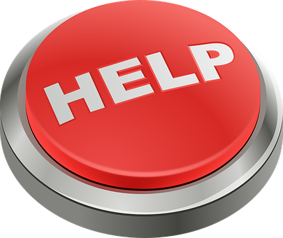
Need Help
Have concerns about your or a friends cannabis use?
  Talk to your health care provider
  Visit your School Nurse
  School Social Worker
Notes:
Talk to your doctor about:
•how much you are drinking or using drugs
•ways to reduce your risks
•what resources may be available to you in your community
References:
Addiction Services of Thames Valley. (2017). Addiction Services of Thames Valley. Retrieved from http://adstv.on.ca/
Middlesex-London Health Unit. (2015). Get help- alcohol and other drug use. Retrieved from https://www.healthunit.com/get-help-now
Pixabay. (n.d.). Help Button. Retrieved from https://pixabay.com/en/help-button-red-emergency-support-153094/

Slide 25
Community Supports
Notes:
TVAS-numerous programs staffed by professionals- support, education and treatment. Services are free and confidential.
CAMH- educational, web-based, research- programs based in Toronto. The Youth Addiction and Concurrent Disorders Service (YACDS) offers treatment to young people (14 to 24 years) who have substance use challenges/concerns, with or without concurrent mental health concerns, and to their families.
Connex- Access to Addiction, Mental Health, and Problem Gambling Services. ConnexOntario provides free and confidential health services information for people experiencing problems with alcohol and drugs, mental illness or gambling. Funded by the Government of Ontario. Helpline is 24/7, confidential and free.

Slide 26
Community Supports
Notes:
CMHA- Promotes good mental health, prevent further illness, offer treatment, support recovery and provide mental health education in the communities of London, Middlesex, Exeter and Goderich.
Reach Out is a confidential 24/7 information, support and crisis service for people living with mental health or addictions concerns in Elgin, Oxford, Middlesex and London.

