Slide 1
Opioid Misuse Prevention
August 2019

Slide 2
What is an opioid?
Notes:
One of the most common types of prescription drugs abused.
Opioids are a family of drugs that have morphine-like effects. The primary medical use for prescription opioids is to relieve pain. Other medical uses include control of coughs and diarrhea, and the treatment of addiction to other opioids. Opioids can also produce euphoria, making them prone to abuse. Some people use opioids for their ability to produce a mellow, relaxed “high.”
Examples of opioids include:
heroin
morphine
fentanyl
codeine
oxycodone
The use of prescription opioids other than their prescribed medical purpose is considered “drug abuse.”
CAMH
http://healthycanadians.gc.ca/healthy-living-vie-saine/substance-abuse-toxicomanie/prescription-abuse-abus-ordonnance/opiods-opiodes-eng.php
Graphic from Shutterstock

Slide 3
True or false: it is considered illegal to possess OPIOID pain medication unless you are a patient with a prescription from a licensed health care professional.
True
False
Notes:
TRUE. Because of their psychoactive properties (properties that affect the mind and mental processes) and their potential for abuse, opioid pain medications are regulated in Canada under the Controlled Drugs and Substances Act (CDSA).
Under the CDSA, it is illegal to:
possess opioid pain medications unless you are a patient with a prescription from a licensed health care professional;
sell or even give away your prescription opioid pain medication to someone else;
"double doctor," i.e., seek a prescription for an opioid pain medication from more than one doctor in a short period of time without the doctor knowing that you have already obtained a prescription from another doctor.
http://www.hc-sc.gc.ca/hl-vs/iyh-vsv/med/ana-opioid-med-eng.php

Slide 4
What are possible long term effects of taking opioids?
Constipation
Decreased sex drive
Menstrual irregularities
Mood swings
All of the above
Notes:
All of the above.
What are the long-term effects of taking opioids?
Long-term use of opioids can cause constipation, decreased interest in sex, menstrual irregularities and mood swings. Addiction to opioids can have devastating long-term social, financial and emotional effects.
http://www.camh.ca/en/hospital/health_information/a_z_mental_health_and_addiction_information/oxycontin/Pages/opioids_dyk.aspx

Slide 5
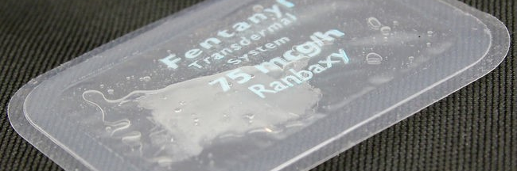
What is Fentanyl?
Notes:
What is fentanyl?
Fentanyl is an opioid. It is usually prescribed in a patch form as a painkiller for managing severe chronic pain or used in hospitals during surgical procedures. It is around 50 to 100 times stronger than morphine. This makes the risk of accidental overdose much higher, especially when used not as prescribed.
There are also different Fentanyls being made illegally and sold on the streets. This illicit fentanyl is often made as a powder and mixed with other drugs (like heroin, cocaine or crack). It is also being pressed into pills and sold as things like ‘oxycodone’ (oxycontin, oxys, eighties) or other pills including speed and ecstasy/MDMA.
Source: StopOverdoseOttawa.ca

Slide 6
Can you tell the difference?
Notes:
What's the risk with counterfeit drugs? Counterfeit pills can be manufactured to look almost identical to prescription opioids (i.e. Oxycontin, Percocet) and other medications. Obtaining drugs from a non-medical source such as a friend, ordering online, or a drug dealer is very risky and potentially life-threatening as there is no way to know what is actually in them or how toxic they may be. Drugs should only be purchased from a local pharmacy or a medical professional.
Source: StopOverdoseOttawa.ca

Slide 7
Addiction
Social Addiction
Physical Addiction
Psychological Addiction
Notes:
Addiction
Addiction consists of three parts: Physical, social, and psychological. In order to successfully break an addiction, you must break all three parts.
Physical Addiction
Does anyone know what this means?
your body physically needs the substance to function normally.
Social Addiction
Can anyone give examples of social addictions?
Most youth addictions start at the social level – it is a leading factor in a person’s choice regarding substance. Eg: peer pressure, rebellion, wanting to feel like an adult. Reasons youth have given for using a substance include: “My friends use it.“, "I just wanted to try it.“, "I thought it was cool.“ and "My parents use it."
Psychological Addiction
What do you think this is?
Psychological addiction refers to the “habit”, and is also called behavioural addiction. It is just part of your routine. When you wake up in the morning, you use an opioid (as you might go for a coffee or breakfast), even if you don’t need it.

Slide 8
What is a risk of taking an opioid that increases even more when taken with other depressant drugs like alcohol?
Heart attack
Breathing can stop
Seizure
Stroke
Muscle spasms
Notes:
Breathing can stop.
Opioids are depressant drugs, which means that they slow down the part of the brain that controls breathing. All opioid drugs are dangerous when taken in large quantities or when taken with other depressants, such as alcohol or benzodiazepines. Death can result, usually because breathing stops. If caught in time, overdose can be treated with drugs such as naloxone, which blocks the effects of opioids, including the effect on breathing.
http://www.camh.ca/en/hospital/health_information/a_z_mental_health_and_addiction_information/oxycontin/Pages/opioids_dyk.aspx

Slide 9
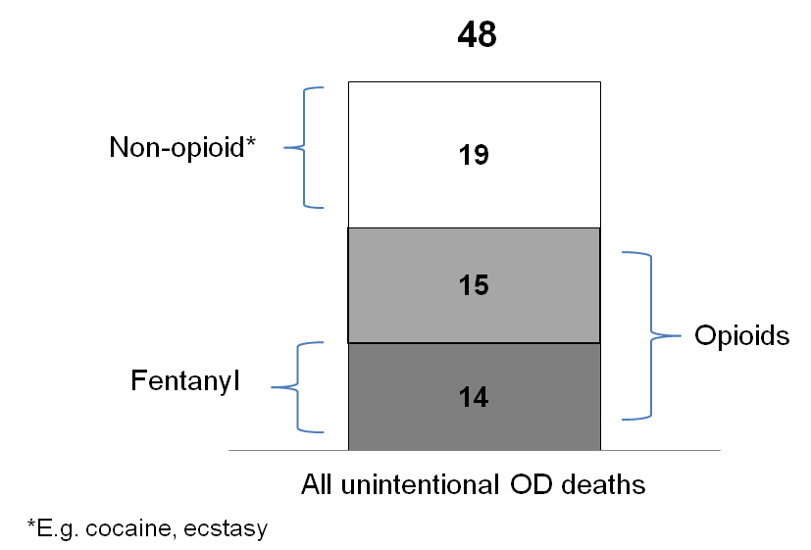
What are the numbers?
914 overdose deaths in B.C. in 2016 related to illicit drug use
Unintentional drug overdose deaths in Ottawa by type of drug involved, 2015
Notes:
914 overdose deaths in B.C. in 2016
http://globalnews.ca/news/3189993/914-overdose-deaths-in-b-c-in-2016-90-occurred-inside/
Unintentional drug overdose deaths in Ottawa by type of drug involved, 2015 Data source: Office of the Chief Coroner for Ontario, extracted December 2, 2016. Analyzed by Epidemiology Team, Ottawa Public Health.

Slide 10
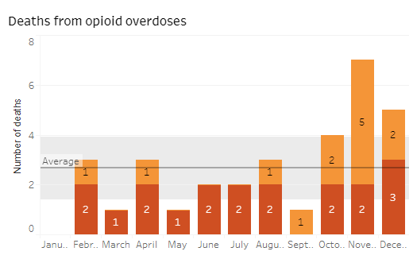
Local Data
in Elgin-St. Thomas and Oxford region
Notes:
Added from https://www.swpublichealth.ca/opioiddashboard
Opioid-related deaths. Light orange representing Elgin. Dark red representing Oxford.
Death rates have been growing in Elgin-St.Thomas and Oxford counties from 2017 - 2018. The highest rate of deaths related to opioid toxicity was seen in November. In Ontario the death rate has been slowly increasing.
Note: Death data for 2016 should be considered as preliminary and is subject to change
Data Source: Ontario Opioid-Related Death database, Office of the Chief Coroner for Ontario Accessible on the Public Health Ontario Interactive Opioid Tool

Slide 11
Overdose
Medical Emergency
Notes:
An overdose is a medical emergency.
You should not be afraid of calling 911 if you or someone you know is experiencing an overdose due to drug use.
There is a Good Samaritan Drug Overdose Act that was recently passed which provides some legal protection for people who experience or witness an overdose and call 911 for help. (see below link for more info.)
(For PHN: Background Info ONLY)
The act can protect you if you are in breach of the following conditions under section 4 (1) of the Controlled Drugs and Substances Act:
Parole
pre-trial release
probation orders
simple possession
conditional sentences
The Good Samaritan Drug Overdose Act applies to anyone seeking emergency support during an overdose, including the person experiencing an overdose. The act protects those who either stay or leave from the overdose scene before help arrives.
The act does not provide legal protection against more serious offences, such as:
outstanding warrants
production and trafficking of controlled substances
all other crimes not outlined within the act

Slide 12
Notes:
MLHU fentanyl fact sheet with overdoes and naloxone information substituted for Ottawa infographic.
**Mention to students: Speaking about overdose may trigger some emotional reactions for those of us here. Support is available at the school to help in the event that this occurs.
An Overdose is when a person uses more of a drug, or a combination of drugs than the body can handle. The brain is no longer able to control basic life functions.
An overdose may look different from one person to the next and depending on the drugs involved.
An overdose is a medical emergency and the first step is always to call 911.
Signs & symptoms of Opioid overdose include:
Breathing is very slow, or irregular, or they may not be breathing at all
Fingernails and/or lips are blue
Body is limp
Deep snoring or gurgling sounds
Loss of consciousness/passed out (can’t wake the person up)
Unresponsive (not answering when you talk to them or shake them)
Pinpoint (tiny) pupils
Vomiting
Source: StopOverdoseOttawa.ca

Slide 13
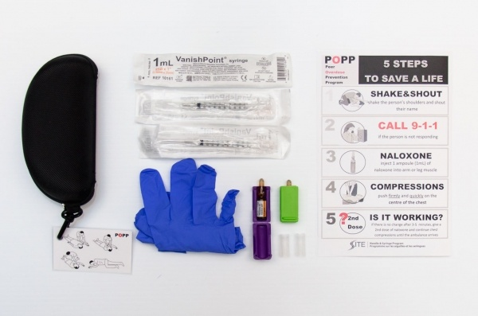
Naloxone
Recognizing the signs of an overdose, calling 911 and having a naloxone kit can save a life
Get a take-home naloxone kit for free from participating pharmacies or the Health Unit
Notes:
What is Naloxone?
Naloxone is a medication that can temporarily reverse the effects of an opioid overdose. Opioids include drugs like heroin, morphine, fentanyl, methadone and codeine.
How does Naloxone work?
In an opioid overdose a person’s breathing slows down or stops. Naloxone blocks the effect of opioids on the brain. It temporarily reverses these effects on a person’s breathing. Giving naloxone can prevent death or brain damage from lack of oxygen.
Naloxone will only work on opioid-related overdoses. It is important to remember that a lot of other drugs are being cut with fentanyl. If the person has used any drugs and is showing signs of an opioid overdose call 911 and give naloxone.
How long does Naloxone take to work?
Naloxone usually starts working in 1 to 5 minutes. Repeated doses may needed if the person is still showing signs of overdose.
The effects of naloxone may last 2 hours however, depending on route of administration, the dose and the opioid used, naloxone may only last 30 to 60 minutes. If the opioid is still in the body after the naloxone wears off, the overdose can return. This is why it is so important to call 911 in every overdose situation!

Slide 14
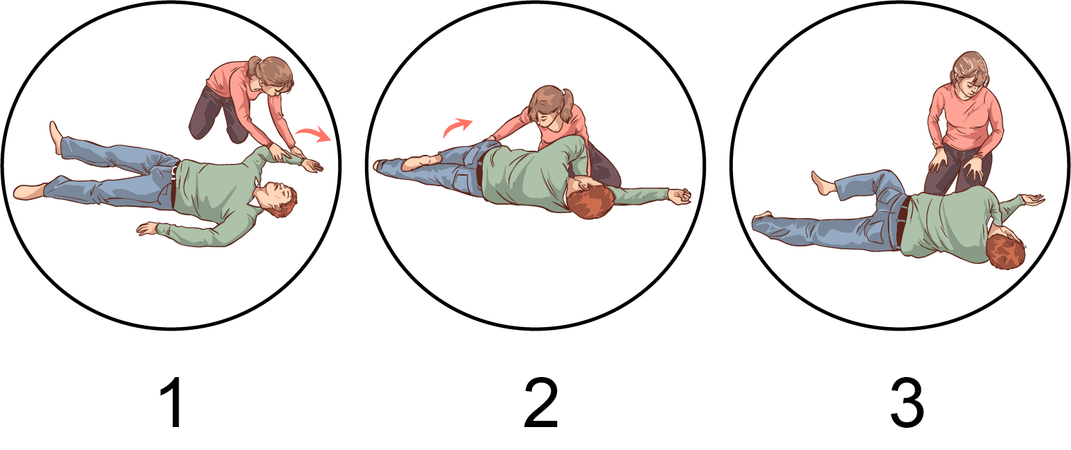
Recovery Position
Notes:
If the person is breathing on their own while waiting for paramedics or if you have to leave the person at any time put them in the recovery position. The recovery position helps keep a person’s airway open so they can breathe and can prevent them from choking on vomit or spit.
Responder extends victim’s closest arm above the victim’s head
Responder positions other arm across the victim’s chest and bends furthest leg at the knee. Victim is rolled towards responder and placed on their side
Victim then lays on their side with their head stabilized on their extended arm. Top knee is bent and stabilized

Slide 15
Overdose Response MYTHS
DO NOT
Put the person in a bath or cold water
Make the person vomit
Inject them with anything other than naloxone (salt water, other drugs, milk, etc.)
Slap or shake the person too hard. Or attempt to wake someone by kicking, burning, or any other way that could cause harm
Let them sleep it off
WHY NOT?
Could drown or put person in shock
Could choke
Will not help and could cause serious harm
Could cause injury
Could stop breathing and die
Notes:
Put emphasis on in an overdose you need to do is CALL 911

Slide 16
Harm Reduction
Don’t use alone
Don’t mix drugs with other drugs or alcohol
Carry Naloxone
Know your tolerance
Notes:
Overdose prevention For individuals that are using: Don’t Use Alone If you overdose when you are alone there will be no one there to help you. When using with someone else, don’t use at the same time. Be sure your friend is willing to call for help, and make a plan for what to do if an overdose happens. If you do use alone, tell someone before you use. Leave the door unlocked and have someone come check on you. Don’t Mix Drugs Don’t mix drugs with other drugs or alcohol. Mixing with other drugs puts you at higher risk of overdose. If you are going to mix, use one drug at a time or use less of each drug.
Carry Naloxone Naloxone is a medication that can temporarily reverse an opioid overdose. Naloxone is available free to people who use drugs and their family and friends! Learn more about Naloxone and where to get a kit.
Know your tolerance Tolerance is the body’s ability to ‘handle’ the effects of the drug being used. Tolerance to a drug develops over time. Drug tolerance will decrease when somebody has taken a break from using – whether intentionally or unintentionally (like while in treatment, hospital or jail). Your tolerance will also change depending on: Weight, Illness, Stress, Lower immune system (from hepatitis for example), Lack of sleep, Other drugs/medications being used, and General health. Use less drugs when your tolerance may be lower. Your risk of overdose increases if you are a new user or haven’t used in 3+ days
**For higher risk students**
Go Slow The quality of street drugs is unpredictable. Fentanyl is being cut (mixed) into both opioid and non opioid drugs: Made as a powder and mixed into cocaine, heroin, and crack. Made as pills and being sold as ‘oxycodone’ (eighties, oxys) or other pills including ecstasy/MDMA. You may not be able to taste, smell or see it. Even very small amounts can cause an overdose. Start using in small amounts and do “testers” (or test doses) to check the strength of what you are using.

Slide 17
True or false: people can develop a tolerance to opioids fairly quickly with regular use?
True
False
Notes:
True. People who use opioids regularly for their pleasurable effects soon develop tolerance to these effects, which means they need to use more and more of the drug to achieve the desired effect. As the amount taken increases, so does the risk of overdose. If people with tolerance stop taking the drug, they lose their tolerance. If they then resume taking the same amount they took before they stopped, the risk of overdose is extreme (This is what happened to Cory from Glee).
http://www.camh.ca/en/hospital/health_information/a_z_mental_health_and_addiction_information/oxycontin/Pages/opioids_dyk.aspx

Slide 18
How can you say no to someone that offers you a drug?
Notes:
In addition to refusal skills, you should consider having an exit strategy with your parents or someone you trust. This is a plan you put into action when you need to get out of a situation – a party, an event or gathering that is not going well or you feel unsafe. That person agrees to pick you up, no questions asked, knowing you made a good decision to leave safely.
Scenarios for discussion:
Scenario 1 (peer pressure)
Three people are at a party. Two of them give the other a pill to take. One of them really does not want to take the drugs. He does not want to take it but he is being pressured to. He takes the pill in his hand and says that he will go get a drink of water to take with the pill. When he is away from his friends getting the water, he throws out the pill but continues to drink the water.
Scenario 2: (In a group with friends)
Kid 1: Are you guys looking for a goodtime
Kid 2: Yea I’m super bored
Kid 1: Alright I just bought these pills, I was waiting for the perfect time
You: Nah, I’m tired I don’t feel like doing this tonight, I need to wake up early tomorrow
Scenario 3: (Before concert)
Kid 1: Alright boys, I’ve been waiting all year for this concert, lets make it special, I brought some pills to keep you dancing
(Everyone starts taking the pills)
Kid 2: Hold on I really need to go to the bathroom, I’ve been holding it in for hours (He leaves and avoids taking the drugs)
EXTRA INFORMATION FOR PHN’s WHEN DISCUSSING ABOVE SCENARIOS
Top 10 Refusal Skills (works well as a role-playing game)
Just say no
2. The broken record
3. Reverse the pressure
4. Suggest a different activity
5. Use humour or make a joke
6. The cold shoulder
7. Walk away
8. Avoid the situation
9. Strength in numbers
10. Make an excuse or give a reason why you can’t

Slide 19
What Causes Emotional Pain?
Notes:
http://www.hc-sc.gc.ca/hl-vs/iyh-vsv/life-vie/stress-eng.php
Healthy Transitions Program Guide CHEO
1. Ask students what can cause stress/emotional pain…. (they give examples)
2. Ask students how their body feels when under stress/emotional pain…..(they may give examples below)
Signs of stress:
Feeling angry, or sad a lot of the time
Changes in your sleep (sleeping too much or too little)
Changes in your appetite
Have a hard time concentrating
Negative thinking (blaming, angry, sad)
Loss of interest or enjoyment in something you used to like to do
Feeling restless, want to get your mind off of your stress but not sure how to do it
3. Use stick man analogy on the board to better illustrate physical pain vs emotional pain….
Physical Pain vs Emotional Pain ****Ask the group to give you some examples of causes of physical pain.
How long would it take for you to tell someone you were sick or in pain and needed help?
Would you be embarrassed to tell someone?
Where would you go for help?
Now ask students what causes stress or emotional pain.
How long would it take for you to tell someone you were hurting or struggling and needed help?
Would you be embarrassed to tell someone about a emotional pain or heart ache? Why?
Where would you go for help?
Note the difference in responses for physical pain and emotional pain (heart ache).
Suggest that things would be much easier for us if we thought about our heart aches the way we think about physical pain or illness (example: not being embarrassed to talk about it, getting help).

Slide 20
Coping with Stress and Emotional Pain
Talk to a friend or a parent
Exercise/Sports
Keep a journal
Meditate
Break something
Yell at someone
Use alcohol or drugs
Walk away from the situation
Watch TV
Use humour
Notes:
Ask students how they cope with stress or emotional pain…
Emphasize the need to:
Identify the problem. Is your job, school, a relationship with someone, or worries about money causing stress?
Solve problems as they come up. What can you do, and what are the possible outcomes?
Talk about your problems. You may find it helpful to talk about your stress. Loved ones may not realize that you’re having a hard time. Once they understand, they may be able to help different ways.
Positive coping strategies:
-Helps to restore emotional balance and/or feel better about yourself
-Respectful of you, others and property
-Helps you to solve the problem
Neutral coping strategies:
-Not positive or negative, but could lead to problems if used too much
-May help to calm you and restore emotional balance
-Are temporary strategies, and should be used with a positive coping strategy to solve the problem
Negative coping strategies:
-Does not restore emotional balance, and may make strong emotions (like anger) even worse
-May be harmful to you, others or property
-Does not solve the problem
-May create more problems
Understand the way you think about situations affects the way you respond to them.
Learn about stress management. There are also counsellors who specialize in stress specific to youth.

Slide 21
Talk To Someone You Trust
Notes:
Talk to someone you trust: Talking to others, and getting help if needed are good strategies for coping with feelings, stress or an addiction. Talking about the current issue may help you feel less worried and anxious. It might also help to solve the problem, sometimes the problem is too big or too hard to handle alone. If you are struggling with substance abuse or know someone who is, it can help or at least prevent things from getting worse. Feels good to know someone understands you and supports you.
Source: Healthy Transitions Facilitator Guide

Slide 22
Where to get help in Elgin/Oxford
Your school nurse, social worker, or guidance counsellor
Addictions Services of Thames Valley www.adstv.on.ca
CMHA crisis centre or call 519-434-9191
Kids Help Phone 1-800-668-6868

