Slide 1
Respiratory Synctial Virus (RSV) Vaccine for LTCH and select RHs
An introduction to access
JAIME FLETCHER
CHIEF NURSING OFFICER / PROGRAM MANAGER

Slide 2
AGENDA
What is RSV and Arexvy®?
Who is eligible for publicly funded Arexvy®?
What do I need to know? What do I need to do?
Ordering doses from SWPH
What if our Home needs help to pull this off? What can SWPH do to assist?
Questions?

Slide 3
Typically manifests as an upper respiratory or asymptomatic infection in health individuals BUT in older adults (especially those with existing comorbid conditions like chronic lung diseases) may result in more severe disease and increased risk of RSV-related hospitalization and mortality. During the 2018-2019 season, RSV accounted for 12.2% of all institutional respiratory infection outbreaks in Ontario. The majority of non-influenza respiratory virus outbreaks occurring in long term care homes.
Overview of RSV (from Public Health Ontario)

Slide 4
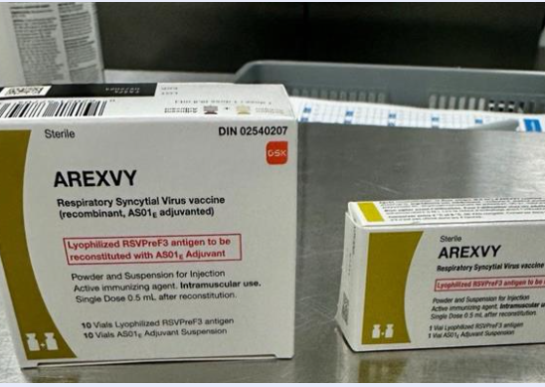
Overview of Arexvy®
Approved by Health Canada on August 4, 2023
Awaiting a NACI statement (expected sometime in 2024)
Adjuvanted vaccine
For LTCH and select Retirement Homes in SWPH residents (MUST be 60 years of age or older to receive)
Administer a single dose (0.5 mL) of Arexvy® as an intramuscular injection

Slide 5
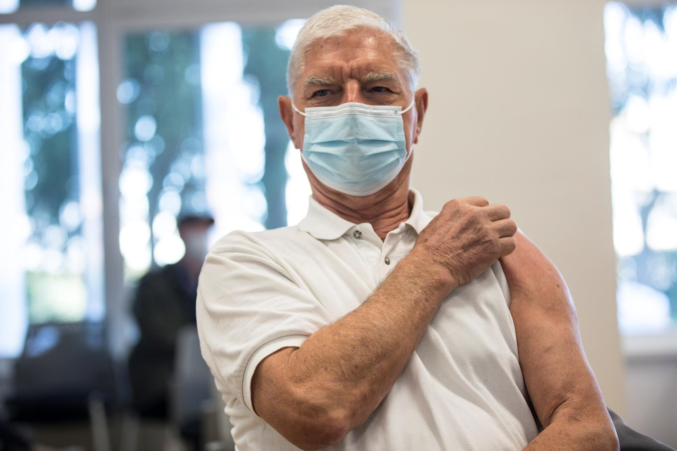
Vaccine Efficacy and Safety Information

Slide 6
Efficacy and Safety Information
24966 participants aged ≥60 years
Overall vaccine efficacy in preventing RSV lower resp tract disease (RSV LRTD) was 82.6% during the first season with high vaccine efficacy observed across various age groups and those with pre-existing medical conditions.
Low vaccine efficacy was observed among those who were ≥80 years (33.8%) or frail (14.9%); however, there were relatively low sample numbers in these populations.
One vaccine dose conferred protection for up to 2 RSV seasons, with a 2nd season vaccine efficacy in preventing RSV LRTD of 56.1%
The GSK RSV vaccine was generally safe and well tolerated among adults aged ≥ 60 years. Local and systemic reactions to the vaccine were generally mild to moderate and self-limiting.
In the Phase 3 trial, 10 events of atrial fibrillation (<0.1%) occurred in the vaccine group vs. 4 events (<0.1%) in the placebo group.
Three (3) serious adverse events were deemed related to vaccine include on case of Miller-Fisher syndrome and 1 case of GBS.

Slide 7
Vaccine Information
From Public Health Ontario Recommendations: Clinical considerations for the Co-Administration of RSV, COVID-19 and Influenza Vaccines Among Older Adults in Long-term Care Facilities (September 25, 2023):
The OIAC recommends that the GSK RSV vaccine be only offered to those who meet eligibility requirements as per Health Canada authorized age indications for the vaccine product.
The OIAC recommends that the GSK RSV vaccine NOT be routinely co-administered with COVID19 vaccine or influenza vaccines. (14 day interval recommended between vaccines – but COVID19 and flu SHOULD be administered together wherever possible).
The OIAC recommends an evaluation of the targeted RSV immunization program be conducted in order to assess the safety and effectiveness of the GSK RSV vaccine among older adults at high risk of severe disease due to RSV.

Slide 8
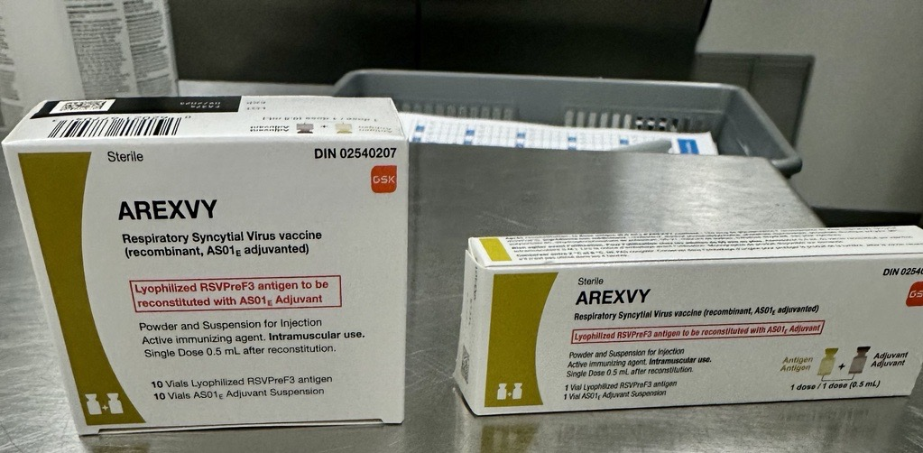
Vaccine Information
Store and transport in cold chain (2° - 8°Celsius)
Comes in a 10 dose vial (VERY limited supply of single doses at SWPH)
Each package contains 10 vials of Lysophilized RSVPreF3 antigen and 10 doses of AS01 Adjuvant Suspension
Requires constitution before use
LIMITED QUANTITIES – only request doses for those residents you have consent for
Once distributed from SWPH, we can not take them back
Current Expiry Date = 09/2024 but Ministry wants these doses in arms
Order form – on our SWPH webpage for Health Care Providers
Reporting - Doses administered should be documented in your EMR – total doses at year end will need to be reported to SWPH (total doses only) for Ministry reporting

Slide 9
What do I need to know? What do I need to do?
The vaccine is NOW available from SWPH
You can administer to eligible residents (60+ only) as soon as 14 days after COVID19 or flu vaccine.
Arrange an order and/or medical directive to administer Arexvy® vaccine to your residents.
Obtain and document consent through your usual processes. Fact sheets for Health Care Providers and Residents/Families were emailed to you last week.
Set a date / plan to vaccinate eligible residents.
Complete an order form from SWPH’s website and tell us your date(s).

Slide 10
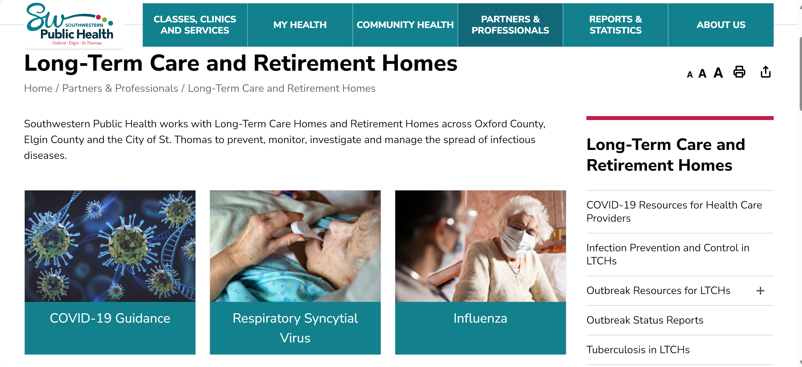
Ordering Doses from SWPH and Online Resources for RSV
NEW - RSV Resources for Health Care Providers on SWPH website including Arexvy® product monograph
Vaccine order forms
Information bulletins from Ministry of Health

Slide 11
Questions?
If you need assistance, please contact:
jfletcher@swpublichealth.ca
1-800-922-0093 ext 1234
Types of assistance we can provide:
Nurse assistance on-site to aid in preloading/ reconstitution
Vaccination supplies (1 cc or 3 cc syringes, tips, alcohol wipes, etc.) if needed
Medical Directive sample sharing (SWPH’s is in progress but won’t be approved until week of November 11th)
Vaccine resources to aid team in developing own orders / medical directives
If major barriers to self-administration, can consult re: possibility of onsite vaccination team in partnership with the LTCH / select Retirement Home (limited resources)

Slide 12
Questions?
Questions? Thank you for attending today!

