Slide 1
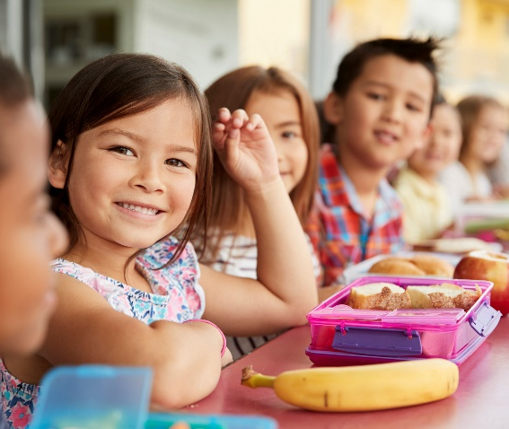
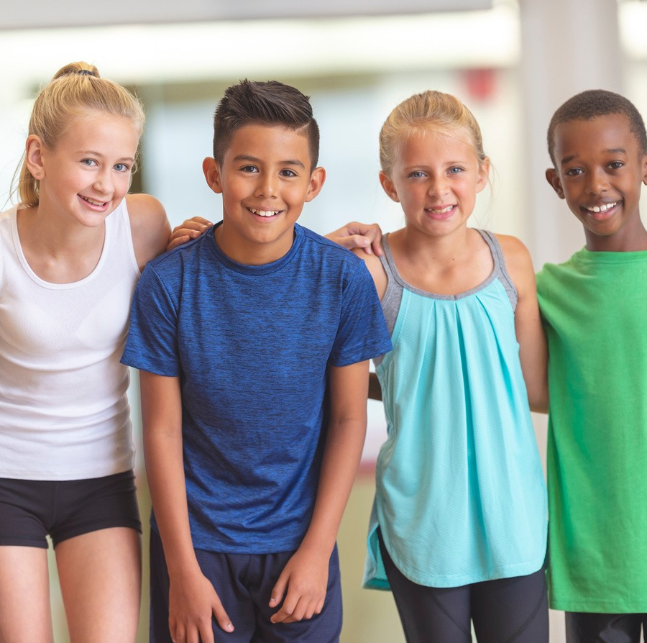
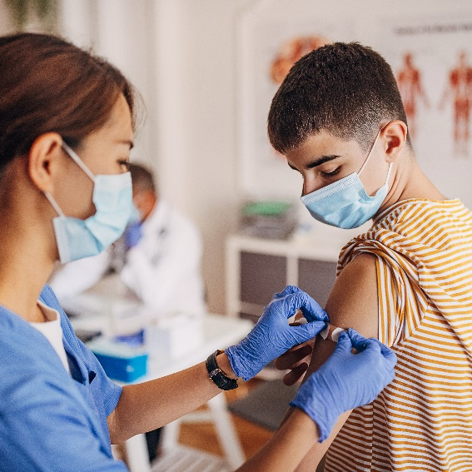
Puberty and Reproduction (recommended for grade 5)
Created by: Child Health Team
Created: November 2019
Updated: March 2020
Notes:
This presentation addresses topic areas of the Human Development and Sexual Health section D1.3 and D1.4 of the Grade 5 Ontario Health and Physical Education Curriculum.
To provide an inclusive environment for all students, regardless of their gender identity, we use the names of body parts and hormones to discuss physical differences rather than the use of gender.

Slide 2
Class Guidelines
Giggling is okay
Be respectful
Everyone is learning, ask questions!
Discuss puberty topics responsibly outside the classroom
Notes:
Ask students to contribute ideas to add to the guidelines

Slide 3
What is puberty?
Time of change from child to adult
Physical changes
Emotional changes
The body becomes fertile
In some cultures, it is a celebrated right of passage
Notes:
There are 3 major growth spurts: 1-the development of a baby before birth, 2-birth to one year old, 3-PUBERTY
Fertile-The body is starting to produce the cells that are necessary to make a baby
Consider asking the class about ceremonies or celebrations that might be celebrated in their families related to puberty

Slide 4
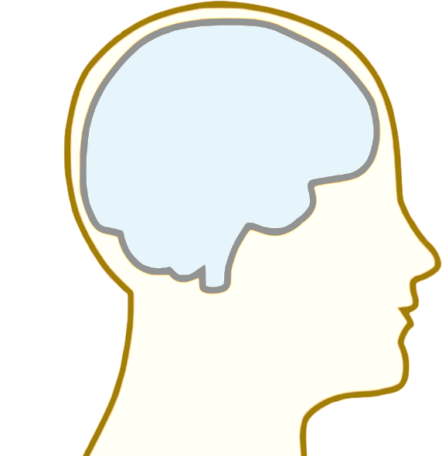
When does puberty start and why?
Puberty begins when youth are between 8-15 years old
The brain sends a signal to the reproductive organs to produce hormones
Notes:
Everyone’s body is different. For example, people are different heights and have different hair colour, it is normal for not everyone to look the same.
When puberty starts and how long the process takes can vary greatly from one person to the other, which is something we don’t have control over and is completely okay.
Image source: https://pixabay.com/vectors/brain-anatomy-man-mind-people-154297/

Slide 5
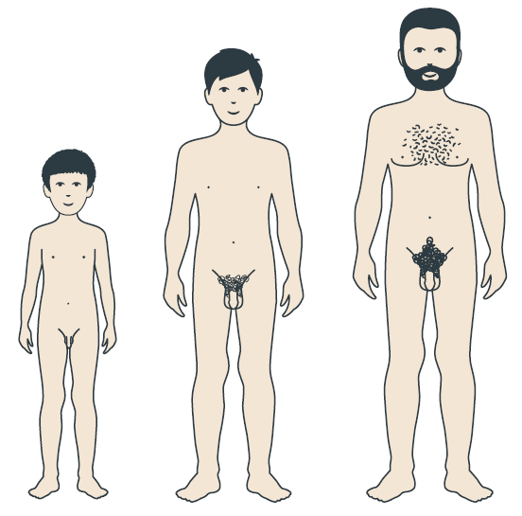
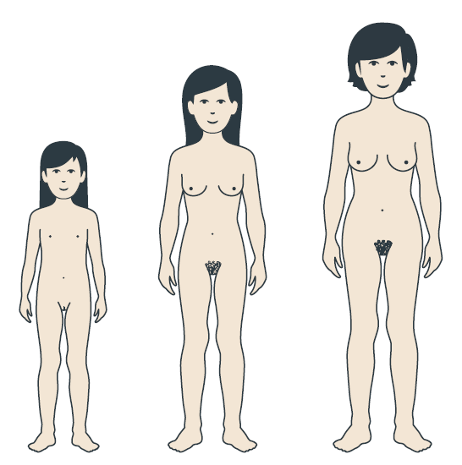
Person with a penis
Person with a vulva
Testosterone
Estrogen
Notes:
The penis and vulva are the external/visible part of the reproductive anatomy (point to penis and vulva for clarification). Many different words are used for these body parts, penis and vulva are the anatomical names.
In a person with a penis, the signal is sent to the testicles to create testosterone
In a person with a vulva, the signal is sent to the ovaries to create estrogen
Testosterone and Estrogen cause changes in the body
Image Source: https://www.secca.org.au/ with permission

Slide 6
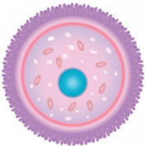
Person with a penis
Person with a vulva
Testosterone
Estrogen
Notes:
During puberty the body is starting to produce the cells that are necessary to make a baby
A person with a penis will start producing sperm in the testicles
A person with a vulva will start having eggs mature in the ovaries
Image Sources: https://www.secca.org.au/ with permission

Slide 7
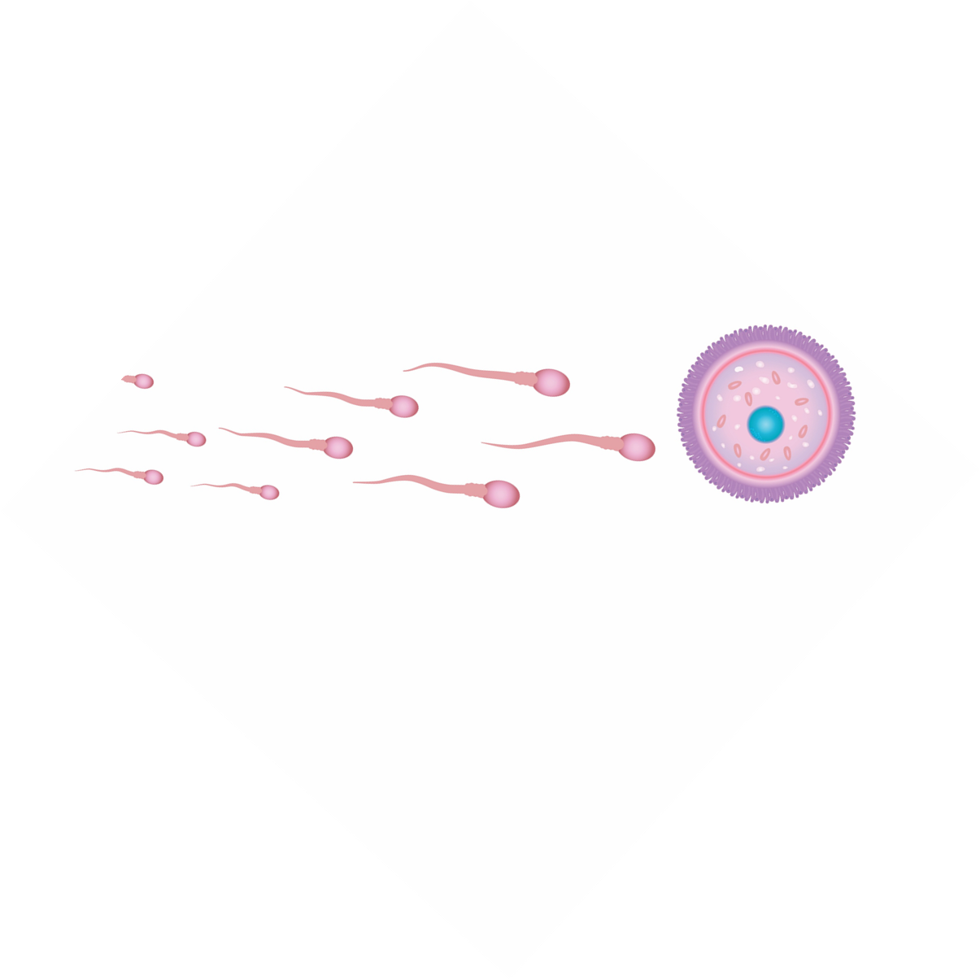
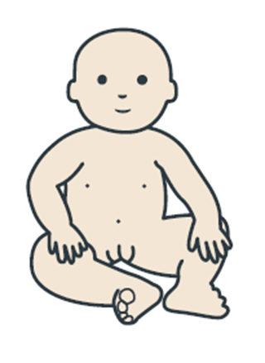
The cells necessary to make a baby
Sperm + Egg = Baby
Notes:
Images not to scale
Image Source: Adobe Stock-purchased (MLHU)
https://www.secca.org.au/ with permission

Slide 8
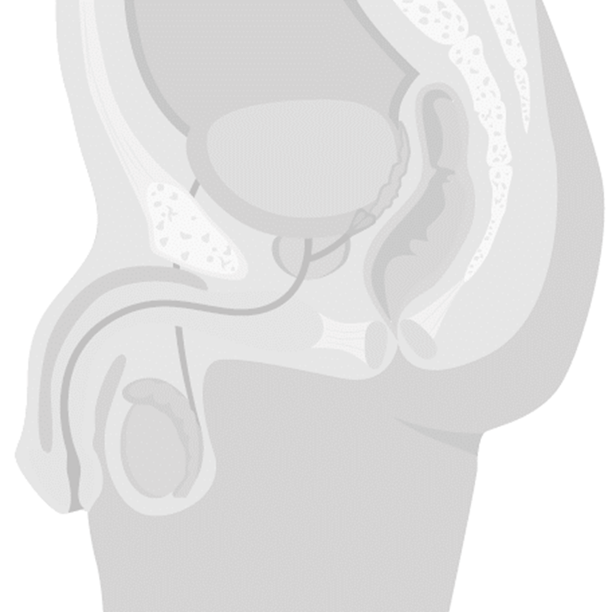
Person with a penis
Bladder
Seminal vesicle
Prostate gland
Vas deferens
Urethra
During puberty, the testicles start making sperm every day, about 400 million per day
Epididymis
Testicle
Scrotum
Notes:
Penis – It is a spongy, muscular organ that becomes enlarged and erect when sexually aroused.
Scrotum – The sac of skin which holds the pair of testes.
Testicles (testes) – The male sex glands which produce sperm and testosterone (a male hormone).
Epididymis – A tube on the surface of each testicle which stores and transports sperm to the vas deferens.
Vas deferens- A tube that transports sperm from the testicle to the seminal vesicle
Seminal vesicles – Pair of glands which add a nourishing fluid to the sperm
Prostate gland – Gland which adds a milky fluid to the semen. Once sperm is combined with the fluid from the seminal vesicles and prostate gland it is called semen
Bladder – A bag-shaped organ which holds the urine until it is discharged.
Urethra – The tube that goes through the penis, through which urine and semen leave the body.
Image Source: Adobe Stock-purchased (MLHU)

Slide 9
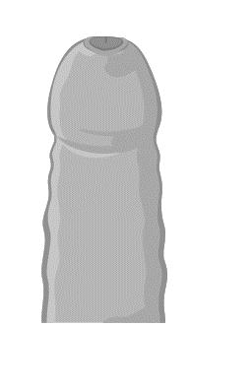
Person with a penis
Foreskin
Glans
Circumcised Penis
Uncircumcised Penis
Notes:
-Penises, like noses and ears and hands, come in all sizes, shapes and colours. They vary how they curve and stick out when erect.
-Some people’s penises are circumcised, the foreskin is removed, others are not and the foreskin covers the glans of the penis
-Whether or not someone is circumcised is can be determined by religious beliefs, family preferences and occasionally medical reasons
Image Source: Adobe Stock-purchased (MLHU)

Slide 10
Person with a penis
What is an erection?
Blood fills the tissue of the penis causing it to harden and become more upright
Erections happen for all kinds of reasons:
When having to go to the bathroom
When nervous or anxious
When the penis is touched
When sexually aroused
Sometime erections just happen for no reason during puberty

Slide 11
Person with a penis
What is ejaculation?
Muscles push the semen into the urethra and out of the penis
The penis is usually erect when semen is going to come out
When does ejaculation happen?
Wet dreams
Masturbation
Notes:
Ejaculation doesn’t happen every time someone gets an erection
Wet Dreams: Sometimes ejaculation happens during sleep- Waking up to a wet sticky spot on bedsheets or in pajamas can happen during puberty. This is called a wet dream.
Masturbation: Touching or rubbing one’s own penis can cause it to get erect and semen to come out. This is called masturbation. Some people masturbate, some don’t

Slide 12
Person with a vulva
Breast development
Estrogen causes breasts to get larger during puberty
Breasts come in many shapes and sizes
Notes:
When breasts develop and what they look like varies from person to person. Breasts may not be the same size once fully developed.
After pregnancy, when the baby is delivered, breast tissue fills with milk which can feed the baby.
Image Source: https://www.secca.org.au/ with permission

Slide 13
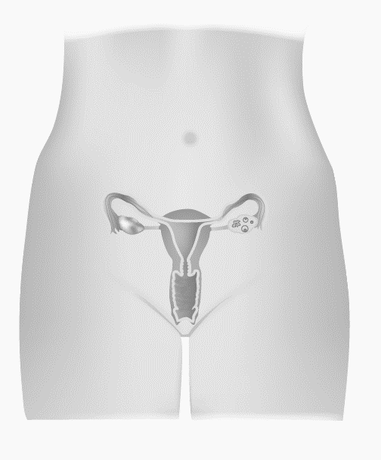
Person with a vulva
Fallopian tubes
Ovaries
Uterus
Cervix
Vagina
Notes:
Vulva – The name for the external genitalia
Ovary – Releases egg cells and produces hormones (estrogen and progesterone) on a monthly cycle.
Fallopian Tubes – Tubes leading from the ovary to the top of the uterus, with finger-like projections that surround an ovary.
Uterus – Pear-shaped organ which nourishes and holds a developing fetus. It prepares for a pregnancy each month by forming a blood and tissue lining.
Cervix – The narrow inner end of the vagina, which leads to the uterus.
Vagina – A muscular tube which expands to fit the penis during intercourse or a baby during birth.
Image Source: Adobe Stock-purchased (MLHU)

Slide 14
Person with a vulva
Clitoris
Labia
Urethral Opening
Vaginal Opening
Anus
Notes:
Labia – Folds of skin (inner and outer) which protect the internal reproduction organs.
Urethral Opening – Opening of the urethra, the tube that connects to the bladder and releases urine
Clitoris – a highly sensitive organ above the urinary opening which may provide pleasure when stimulated.
Anus – Opening of the rectum, where feces is released
Image Source: Adobe Stock-purchased

Slide 15
Person with a vulva
Menstruation
https://www.youtube.com/watch?v=vXrQ_FhZmos
Notes:
https://www.youtube.com/watch?v=vXrQ_FhZmos
*Note to teachers: This video includes the use of gendered language (woman, girl, her) in the explanation of menstruation. In this presentation we endeavour to be more inclusive in our education, recognizing that not all youth identify with a specific gender.

Slide 16
Person with a vulva
When does menstruation start?​
No one can tell exactly when it will start​
White or yellow discharge in the underwear can be a sign that a period is coming within the next year​
Periods may not come every month at first
Be prepared: ​
Consider having extra pads and underwear with you at school

Slide 17
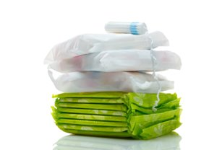
Menstrual Products
Used to catch blood and discharge keeping underwear clean
Pantyliners/Menstrual pads
Tampons
Menstrual cups
Menstrual underwear
All menstrual products need to be changed every couple hours to prevent infections
Notes:
Pantyliner: thin pad used for discharge or when expecting period
Menstrual pad: sticks to inside of underwear during a period
Tampon: inserted in the vagina to catch blood and discharge.
Menstrual cup: reusable, flexible cup that is placed inside the vagina to catch blood and discharge, emptied every 4-12 hours
Menstrual underwear: reusable, absorbent underwear used in addition to or instead of other menstrual products.
The type of menstrual product used is a personal choice.

Slide 18
Person with a vulva
Menstruation may cause:​
Breast tenderness or pain​
Period Cramps​
Aches or cramps in the lower part of your belly​
Backache​
Ache along your inner thigh​
Pre-Menstrual Syndrome(PMS) ​
Feeling swollen, headaches, acne, abdominal cramps, tired, sad, and irritable
Notes:
Breasts- due to the level of hormones before and during your period breasts may hurt or feel tender . This is caused from a change in hormone level which causes a build up of fluid in the breast. ​
Period Cramps - This can include aches or cramps in the lower part of your belly, backache and ache along your inner thigh.. This does not happen to everyone but is common. ​
Pre-Menstrual Syndrome(PMS)- the name given to symptoms which one might experience 1-14 days before your period begins. Symptoms include breast tenderness, feeling swollen or bloated, changes in appetite, headaches, constipation or diarrhea, abdominal cramps , feeling sad, tired, irritable and clumsy. ​
Everyone experiences a different combination of symptoms.

Slide 19
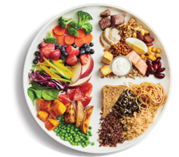
Person with a vulva
Managing period symptoms:​
Be physically active ​
Go for a walk, swim, bike or play your favourite sport.​
Take a warm bath​
Place a warm heating pad or hot water bottle on your abdomen
Eat a variety of foods every day
Notes:
If symptoms continue to be a problem talk to a trusted adult or healthcare provider​
​
Image source: https://www.canada.ca/en/health-canada/services/canada-food-guide/resources/resources-download.html​

Slide 20
Feelings
Everyone has different feelings during puberty…this is completely normal!
What are some of the feelings you might experience?

Slide 21
Notes:
You may have mood swings
You may love your friends or family at times and not want to have anything to do with them at other times.
Sometimes you may feel grown-up, other times like a kid.
There may be lots of tears and arguments.
Changing hormones cause some of these feelings.
Image source: Wordart.com

Slide 22
How can puberty affect relationships?
Changing interests may change friendships
Some people start “liking” others
Might be treated like they are older because of their changing body
Teasing
Notes:
Everyone “should be treated in an age-appropriate and respectful way” (Ontario Curriculum, Grades 1-8; Health and Physical Education 2019)
It is not okay to tease people about changes related to puberty, do not draw attention to changes someone might be experiencing or make them self conscious.

Slide 23
Where can you get more information?
Parents or other family members
Other trusted adults (teachers)
Health professionals
Notes:
Parents can be a really good source of information when it comes to changes during puberty. They can answer questions and give great advice. Students are encouraged to share what they have learned with their parents and ask a trusted adult to answer any of their questions regarding puberty.

